Slide 1
Chapter 6 Skin and the Integumentary System
Composed of several tissues
Maintains homeostasis
Protective covering
Retards water loss
Regulates body temperature
Houses sensory receptors
Contains immune system cells
Synthesizes chemicals, including Vitamin D
Excretes small amounts of waste

Slide 2
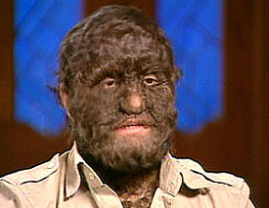
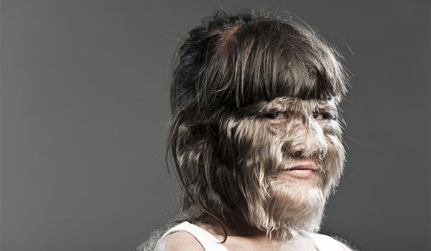
Hypertrichosis- extra “chunk” of genes on X chromosome
5 million hair follicles of an adult develop by 5th month prenatal
Newborns lanugo recede beneath skin surface
gene called SOX3; mutation to a section of the X chromosome

Slide 3
What advantages might lighter coats have afforded our ancestors? Explain why this almost uniquely human trait has persisted?

Slide 4
Physiology
Regulation of body temperature
Protection
Sensation
Excretion
Immunity
Blood reservoir
Synthesis of Vitamin D- most active form of vitamin D calcitriol

Slide 5
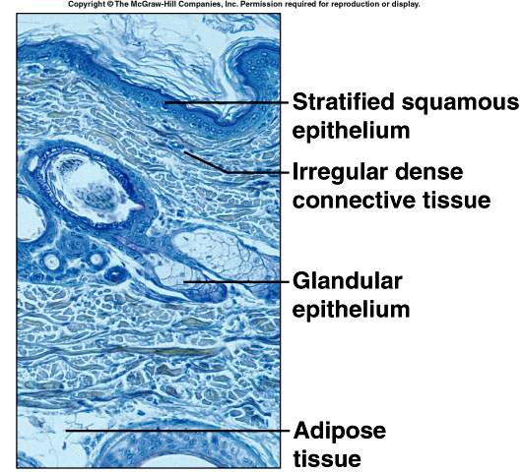
Layers of Skin
Epidermis
Dermis
Subcutaneous layer

Slide 6
Epidermis, Dermis, & Basement Membrane
Epidermis is subdivided into layers of stratified squamous epithelium
Dermis is made up of connective tissue, epithelial tissue, smooth muscle tissue, nervous tissue, and blood.
Basement membrane is anchored to the dermis by short fibrils and separates these two layers of skin

Slide 8
6.1 Introduction
A. Organs are body structures composed of two or
more different tissues.
B. The skin and its accessory organs make up the integumentary system.
C. The skin includes two distinct layers:
a) outer layer, called the epidermis, which is composed of stratified squamous epithelium.
b) inner layer, or dermis is thicker than the epidermis and contains connective tissue
* both layers are discussed later in the notes

Slide 9
Types of Epithelial Membranes
Serous
line body cavities that lack openings to outside
reduce friction
inner lining of thorax and abdomen
cover organs of thorax and abdomen
secrete serous fluid
Mucous
line tubes and organs that open to outside world
lining of mouth, nose, throat, etc.
secrete mucus
Cutaneous
covers body
skin

Slide 10
6.2 Types of Membranes
A. Serous membranes line body cavities that lack openings to the outside.
1. They line the thorax and abdomen and cover the organs within these cavities.
2. Serous membranes are made up of epithelium and loose connective tissue and secrete serous fluid that acts as a lubricant.
B. Mucous membranes line the cavities and openings that lead to the outside of the body, including the oral and nasal cavities, and openings of the digestive, reproductive, respiratory, and urinary systems.
1. They consist of epithelium and connective tissue with specialized cells that secrete mucus.

Slide 11
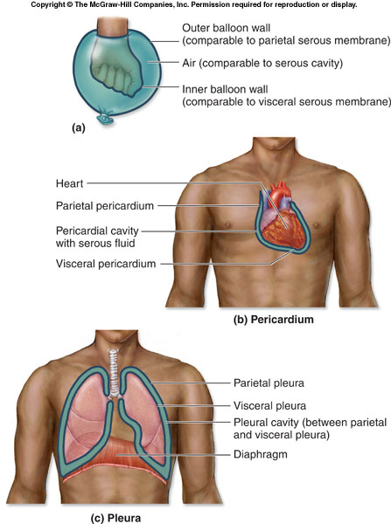
Serous membranes line body cavities that lack openings to the outside.

Slide 12
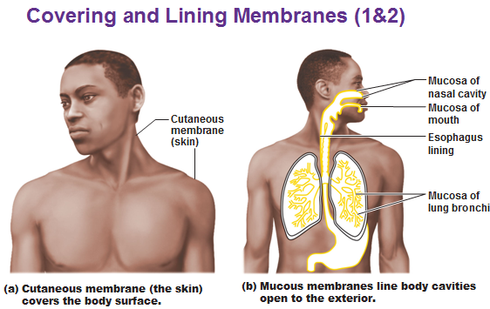
Mucous membrane

Slide 13
6.2 Types of Membranes cont.
C. Synovial membranes line the joint cavities.
1. These membranes consist of connective tissue only that secretes lubricating synovial fluid.
D. The final membrane type is the cutaneous membrane consists of the skin, and is the subject of the remainder of this chapter.

Slide 14
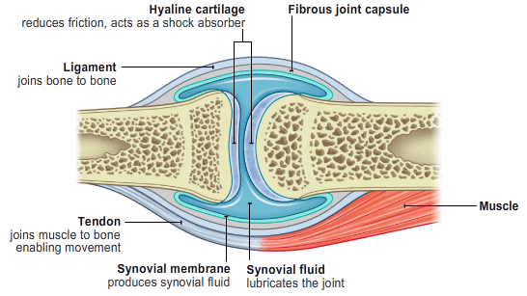
Human Knee- Synovial membranes

Slide 15
Skin and Its Tissues cont.
A. The skin is a large organ responsible for maintaining homeostasis through temperature regulation, protection of underlying tissues, retardation of water loss, housing sensory receptors, synthesizing certain chemicals, protection from infection (barrier) and excreting wastes.
B. The skin consists of an outer epidermis and a dermis, connected to underlying tissue by the subcutaneous layer (hypodermis).

Slide 17
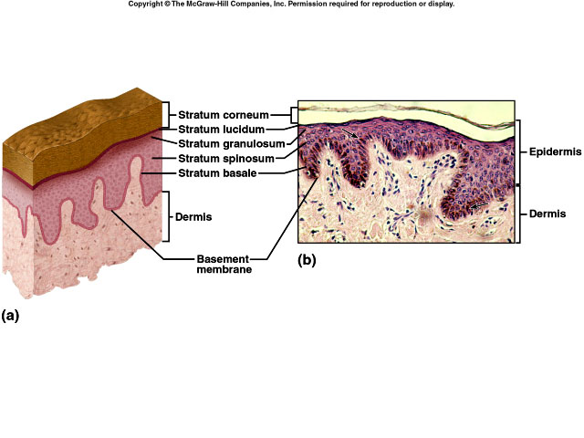
Epidermis
Layers of Epidermis
stratum corneum
stratum lucidum
stratum granulosum
stratum spinosum
stratum basale

Slide 18
Epidermis
1. The epidermis is made up of stratified squamous epithelium and lacks blood vessels.
2. The layer of reproducing cells (the stratum basale), which lies at the base of the epidermis, is well-nourished by dermal blood vessels. Made of cubodial- or columnar-shaped cells. Stem cells multiple, producing keratinocytes, which move to superficial surface.
3. Cells are pushed outward as new cells are formed, and become keratinized as they die. Nuclei degenerate.

Slide 19
Epidermis
lacks blood vessels
keratinized
thickest on palms and soles (0.8-1.4mm)
melanocytes provide melanin
rests on basement membrane
stratified squamous

Slide 20
Epidermis
4. As a result of keratinization many layers of tough, tightly packed dead cells accumulate in the outermost epidermis (superficial), forming a layer called the stratum corneum. The dead cells that compose it are eventually shed.
5. Stratum lucidum is the thickened skin of the palms and soles.
6. The epidermis is important because it protects against water loss, mechanical injury, chemicals, and microorganisms.

Slide 21
Epidermis (contiuned)
7. Melanocytes, which lie deep in the epidermis and underlying dermis, produce a pigment called melanin that protects deeper cells from the sun's ultraviolet rays.
8. Melanocytes pass melanin to nearby cells through cytocrine secretion.

Slide 22
What is Melanoma?
The most dangerous form of skin cancer, melanoma begins in a type of skin cell called a melanocyte.
Melanocytes produce the skin pigment known as melanin, which is responsible for our natural skin color.
Exposed to sunlight, these skin cells produce large amounts of melanin as part of the tanning process, helping to protect the skin from burning.

Slide 23
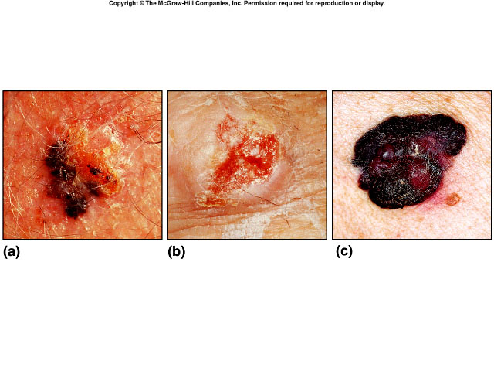
Types of Skin Cancer
Squamous cell carcinoma – derived from epithelial tissue
Basal cell carcinoma – derived from epithelial tissue
Malignant melanoma – derived from melanocytes

Slide 24
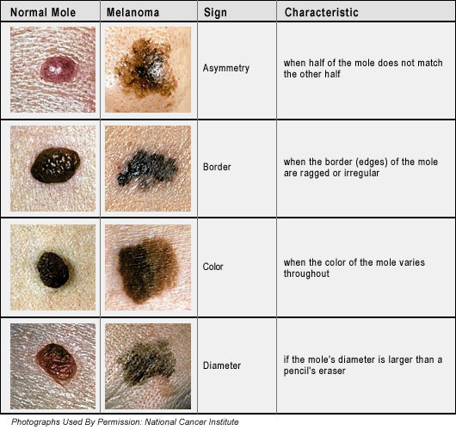

Slide 25
Skin Color
1. Skin color results from a combination of genetic, environmental, and physiological factors.
2. Genetic differences in skin color result from differing amounts of melanin and in the size of melanin granules.
3. Exposure to sunlight causes darkening of skin as melanin production increases.
4. Circulation within dermal blood vessels affects skin color.

Slide 26
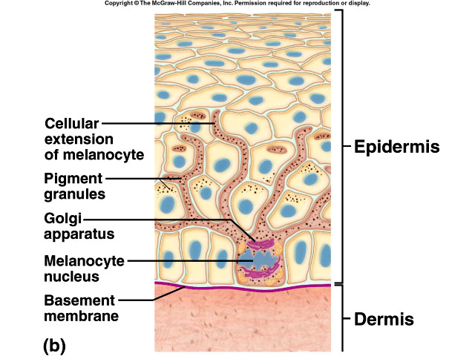
Melanocytes and Pigment Granules

Slide 27
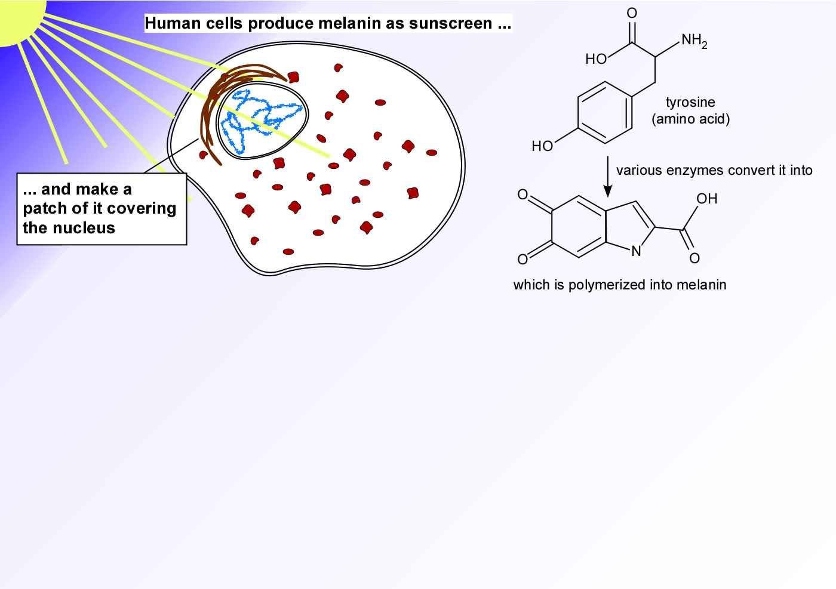
How do we protect our DNA?

Slide 28
Melanocytes-Add to notes
Melanocytes synthesize melanin from the amino acid tyrosine in the presence of an enzyme called tyrosinase.
Synthesis occurs in an organelle caled melanosome.
UV radiation increases enzymatic activity
Albinos have melanocytes

Slide 29
Dermis
1. The dermis binds the epidermis to underlying tissues.
2. The dermis consists of connective tissue with collagen and elastic fibers within a gel-like ground substance.
3. Dermal blood vessels carry nutrients to upper layers of skin and help to regulate temperature.
4. The dermis also contains nerve fibers, sensory fibers, hair follicles, sebaceous glands, and sweat glands.

Slide 30
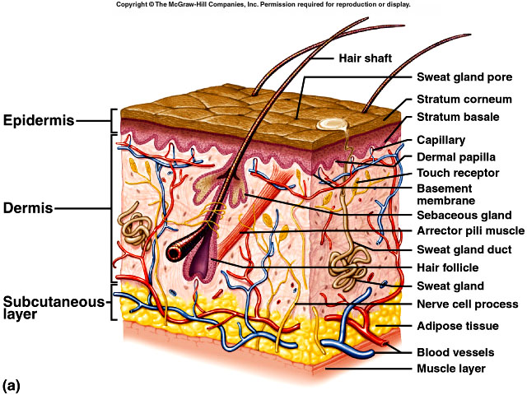
Dermis
on average 1.0-2.0mm thick
dermal papillae
binds epidermis to underlying tissues
irregular dense connective tissue
muscle cells
nerve cell processes
blood vessels
hair follicles
glands

Slide 31
Production of vitamin D
Skin cells help to produce vitamin D, which is necessary for normal bone and tooth development.
Vitamin can be obtained in the diet or can be formed from a substance (dehydrocholesterol).
When dehydrocholesterol reaches the skin by blood and exposed to UV rays, this compound is converted to a substance that becomes vitamin D.

Slide 32
Production of vitamin D addition
When dehydrocholesterol reaches the skin by blood and exposed to UV rays, this compound is converted to an inactive form of Vitamin D. This inactive form goes to the Liver and Kidney where it gets transformed into the active form of Vitamin D known as calcitriol.

Slide 33
Subcutaneous Layer
1.The subcutaneous layer (hypodermis) is composed of loose connective tissue and insulating adipose tissue.
2. It binds the skin to underlying organs and contains the blood vessels that supply the skin.
3. No sharp boundary exists between the dermis and subcutaneous layer.

Slide 34
Subcutaneous Layer
hypodermis
loose connective tissue
adipose tissue
insulates
major blood vessels

Slide 35
6.4 Accessory Organs of the Skin
A. Hair Follicles
1. Hair can be found in nearly all regions of the skin.
2. Individual hairs develop from cells at the base of the hair follicle, an invagination of the lower epidermis that dips down into the dermis.
3. As new cells are formed, old cells are pushed outward and become keratinized, forming the hair shaft.

Slide 36
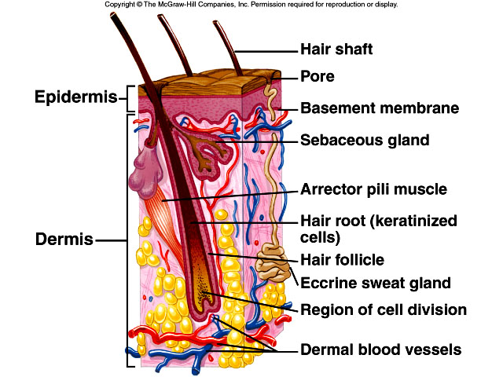

Slide 37
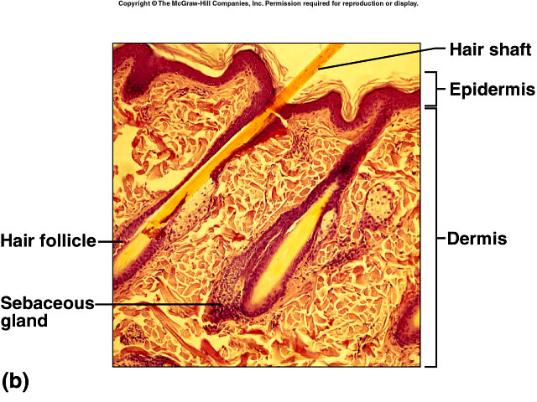

Slide 39
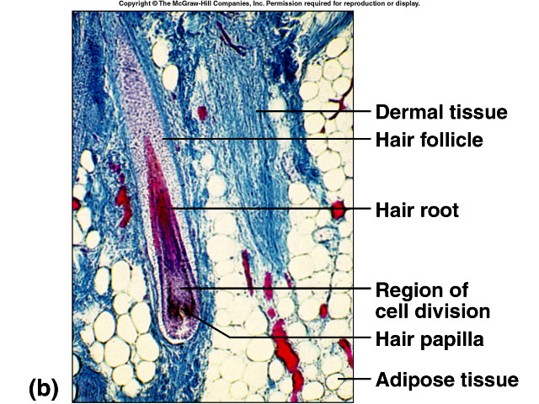

Slide 40
Accessory Organs cont.
4. A bundle of smooth muscle cells, called the arrector pili muscle, is attached to each hair follicle.
5. Hair color is determined by genetics; melanin from melanocytes is responsible for most hair colors, but red hair also contains the pigment trichosiderin.

Slide 41
Sebaceous Glands
1. Sebaceous glands (holocrine glands) are associated with hair follicles and secrete sebum that waterproofs and moisturizes the hair shafts.
Responsible for acne and can become overactive in response to hormonal changes.
Can result in blackheads; if pus-forming bacteria are present, pimples develop in the follicles.

Slide 42
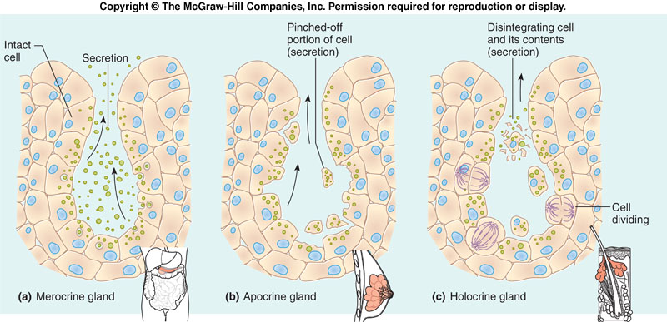
Glandular Epithelium Exocrine Glands

Slide 43
Sebaceous Glands (Figs. 6.6)

Slide 44
Nails
1. Nails are protective coverings over the ends of fingers and toes.
2. Nails consist of stratified squamous epithelial cells overlying the nail bed, with the lunula as the most actively growing region of the nail root.
3. As new cells are produced, older ones are pushed outward and become keratinized.

Slide 45
Nails (Fig. 6.7)

Slide 46
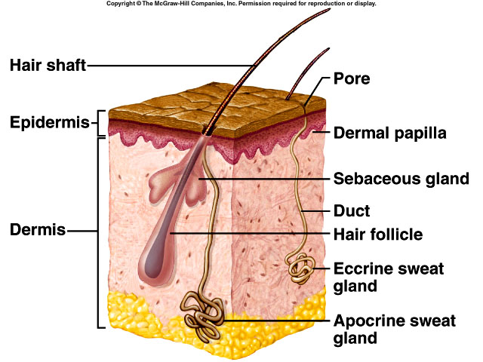
Sweat or Sudoriferous Glands
widespread in skin
deeper dermis or hypodermis
eccrine glands – types of merocrine gland that secrete fluid (sweat) product released through the cell membrane
aprocrine sweat, ceruminous (wax), & mammary (milk) glands – types of aporocrine glands that secrete cellular product and portion of the free ends of cells

Slide 47
Sweat Glands
1. Sweat glands (sudoriferous glands) are either eccrine, which respond to body temperature,or apocrine, which respond to body temperature, stress, and sexual arousal.
2. Modified sweat glands, called eruminous glands, secrete wax in the ear canal.
3. Mammary glands, another modified type of sweat glands, secrete milk.

Slide 48
6.5 Regulation of Body Temperature
A. Proper temperature regulation is vital to maintaining metabolic reactions.
B. The skin plays a major role in temperature regulation.
C. Active cells, such as those of the heart and skeletal muscle, produce heat.

Slide 49
Negative Feed-back

Slide 50
Regulation of Body Temp cont.
D. Heat may be lost to the surroundings from the skin.
E. The body responds to excessive heat by dilation of dermal blood vessels and sweating.
F. The body responds to excessive cooling by constricting dermal blood vessels, inactivating sweat glands, and shivering.

Slide 51
6.6 Healing of Wounds and Burns
A. Inflammation, in which blood vessels dilate and become more permeable, causing tissues to become red and swollen, is the body's normal response to injury.
B. Superficial cuts are filled in by reproducing epithelial cells.

Slide 52
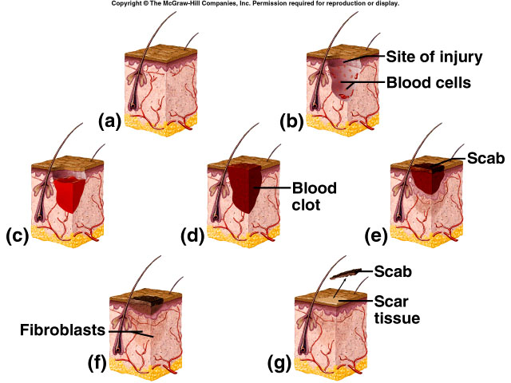
Healing of Cuts

Slide 53
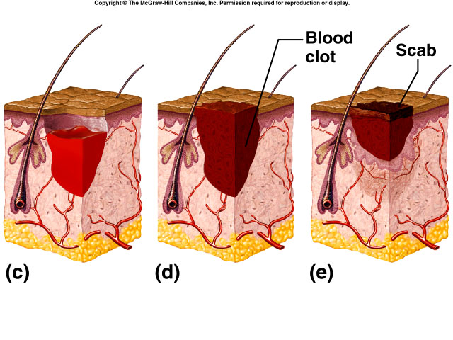

Slide 54
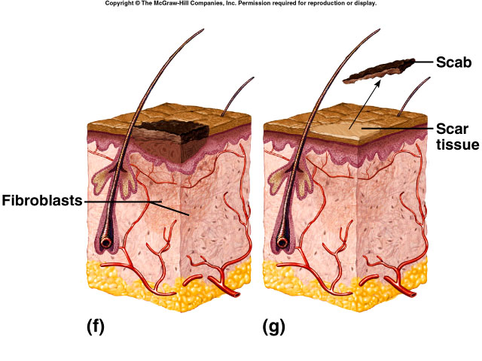

Slide 55
Healing of Burns
First degree burn – superficial partial-thickness (epidermis damaged)
Second degree burn – deep partial-thickness (epidermis & dermis damaged)
Third degree burn – full-thickness (epidermis, dermis, & accessory skin structures)
autograft (self-transplant)
homograft (temporary transplant from donor)
various skin substitutes
extensive scars

Slide 56
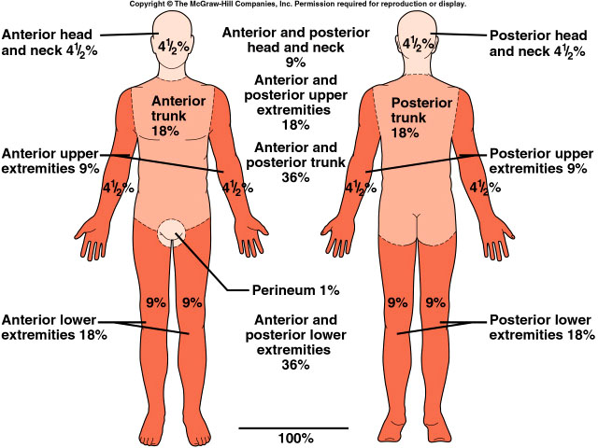
Rule of Nines

Slide 57
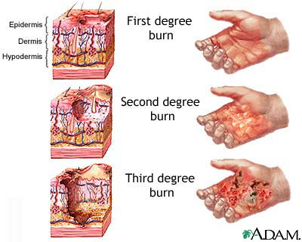
Pictures & Images

Slide 58
Healing of Wounds and Burns cont.
C. Deeper cuts are closed off by clots, covered by scabs, and eventually filled in by fibroblasts, making connective tissue. Blood vessels extend into the area, injured tissues are replaced, and the scab falls off.
D. Large wounds leave scars and healing may be accompanied by the formation of granulations.

