Slide 1
5
Tissue: The Living Fabric
Part A

Slide 2
Tissues
Groups of cells similar in structure and function
The four types of tissues
Epithelial
Connective
Muscle
Nerve

Slide 3
Epithelial Tissue
Cellularity – composed almost entirely of cells
Special contacts – form continuous sheets held together by tight junctions and desmosomes
Polarity – apical and basal surfaces
Supported by connective tissue – reticular and basal laminae
Avascular but innervated – contains no blood vessels but supplied by nerve fibers
Regenerative – rapidly replaces lost cells by cell division

Slide 4
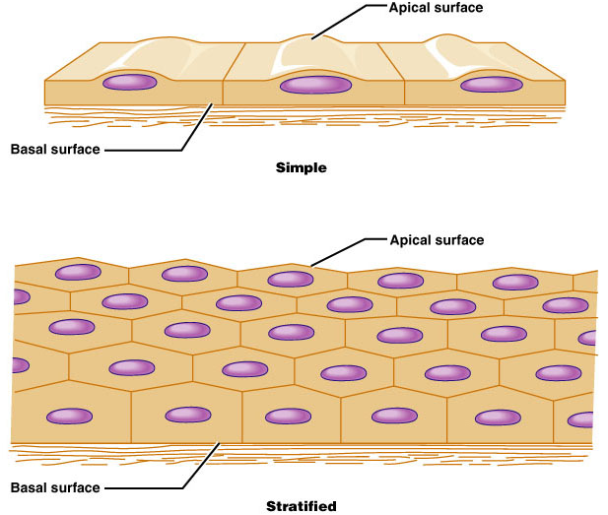
Classification of Epithelia
Simple or stratified
Figure 4.1a

Slide 5
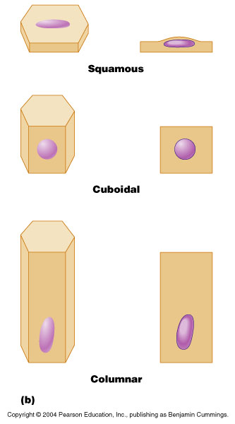
Classification of Epithelia
Squamous, cuboidal, or columnar
Figure 4.1b

Slide 6
Epithelia: Simple Squamous
Single layer of flattened cells with disc-shaped nuclei and sparse cytoplasm
Usually the lining of serous membranes.
Functions
Diffusion and filtration
Provide a slick, friction-reducing lining in lymphatic and cardiovascular systems
Present in the kidney glomeruli, lining of heart, blood vessels, lymphatic vessels, and serosae

Slide 7
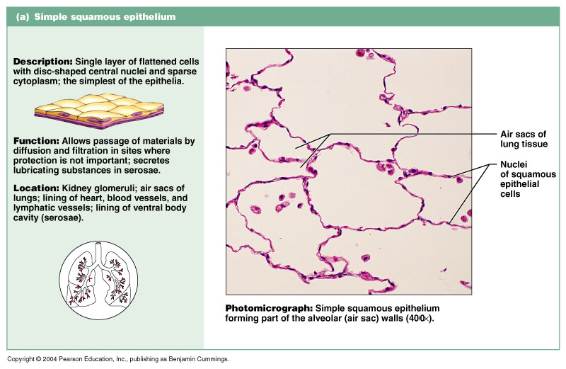
Epithelia: Simple Squamous
Figure 4.2a

Slide 8
Epithelia: Simple Cuboidal
Single layer of cubelike cells with large, spherical central nuclei
Function in secretion and absorption
Present in kidney tubules, ducts and secretory portions of small glands, and ovary surface

Slide 9
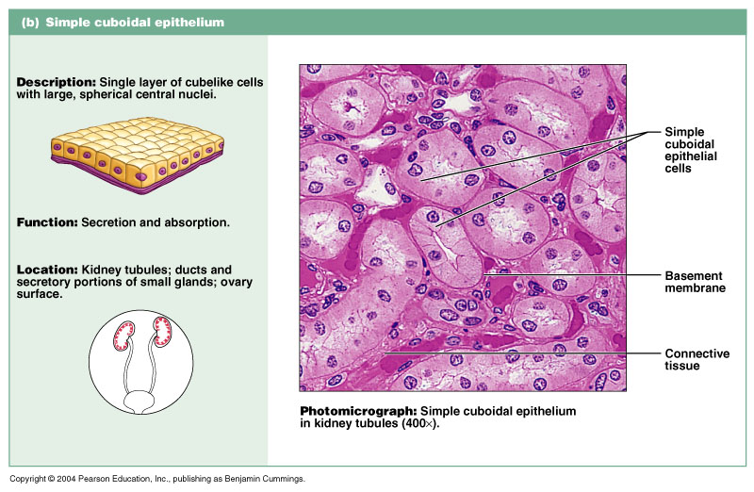
Epithelia: Simple Cuboidal
Single layer of cubelike cells with large, spherical central nuclei
Function in secretion and absorption
Present in kidney tubules, ducts and secretory portions of small glands, and ovary surface
Figure 4.2b

Slide 10
Epithelia: Simple Columnar
Single layer of tall cells with oval nuclei; many contain cilia
Goblet cells are often found in this layer
Function in absorption and secretion
Nonciliated type line digestive tract and gallbladder
Ciliated type line small bronchi, uterine tubes, and some regions of the uterus
Cilia help move substances through internal passageways

Slide 11
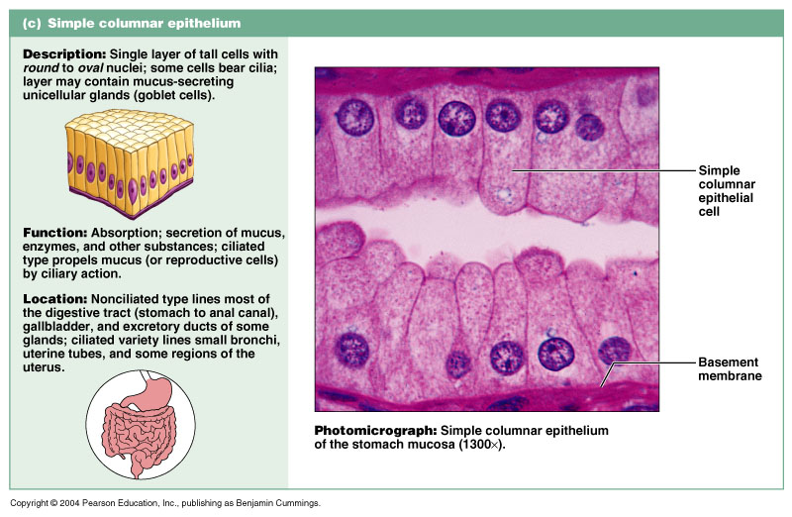
Epithelia: Simple Columnar
Figure 4.2c

Slide 12
Epithelia: Pseudostratified Columnar
Single layer of cells with different heights; some do not reach the free surface
Nuclei are seen at different layers
Function in secretion and propulsion of mucus
Present in the male sperm-carrying ducts (nonciliated) and trachea (ciliated)

Slide 13
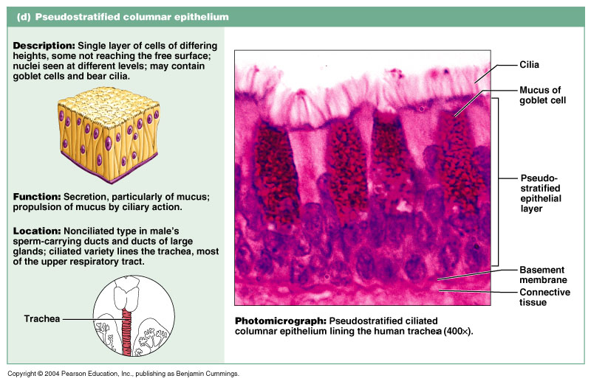
Epithelia: Pseudostratified Columnar
Single layer of cells with different heights; some do not reach the free surface
Nuclei are seen at different layers
Function in secretion and propulsion of mucus
Present in the male sperm-carrying ducts (nonciliated) and trachea (ciliated)
Figure 4.2d

Slide 14
Epithelia: Stratified Squamous
Thick membrane composed of several layers of cells
Function in protection of underlying areas subjected to abrasion
Forms the external part of the skin’s epidermis (keratinized cells), and linings of the esophagus, mouth, and vagina (nonkeratinized cells)

Slide 15
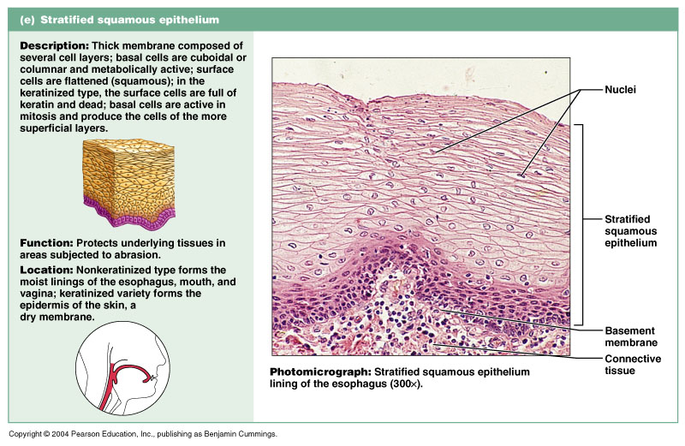
Epithelia: Stratified Squamous
Thick membrane composed of several layers of cells
Function in protection of underlying areas subjected to abrasion
Forms the external part of the skin’s epidermis (keratinized cells), and linings of the esophagus, mouth, and vagina (nonkeratinized cells)
Figure 4.2e

Slide 16
Epithelia: Stratified Cuboidal and Columnar
Stratified cuboidal
Quite rare in the body
Found in some sweat and mammary glands
Typically two cell layers thick
Stratified columnar
Limited distribution in the body
Found in the pharynx, male urethra, and lining some glandular ducts
Also occurs at transition areas between two other types of epithelia

Slide 17
Epithelia: Transitional
Several cell layers, basal cells are cuboidal, surface cells are dome shaped
Stretches to permit the distension of the urinary bladder
Lines the urinary bladder, ureters, and part of the urethra

Slide 18
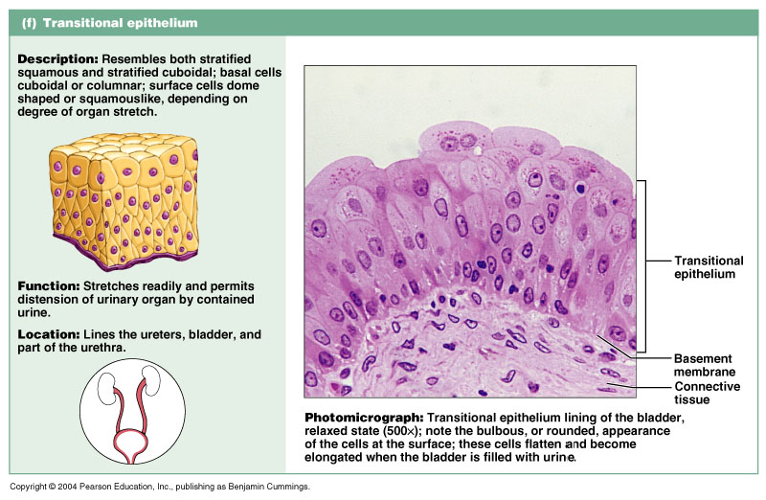
Epithelia: Transitional
Several cell layers, basal cells are cuboidal, surface cells are dome shaped
Stretches to permit the distension of the urinary bladder
Lines the urinary bladder, ureters, and part of the urethra
Figure 4.2f

Slide 19
Epithelia: Glandular
A gland is one or more cells that makes and secretes an aqueous fluid
Classified by:
Site of product release – endocrine or exocrine
Relative number of cells forming the gland – unicellular or multicellular

Slide 20
Endocrine Glands
Ductless glands that produce hormones
Secretes their products directly into the blood rather than through ducts
Secretions include amino acids, proteins, glycoproteins, and steroids

Slide 21
Exocrine Glands
More numerous than endocrine glands
Secrete their products onto body surfaces (skin) or into body cavities
Examples include mucous, sweat, oil, and salivary glands
The only important unicellular gland is the goblet cell
Multicellular exocrine glands are composed of a duct and secretory unit

Slide 22
Multicellular Exocrine Glands
Classified according to:
Simple or compound duct type
Structure of their secretory units

Slide 23
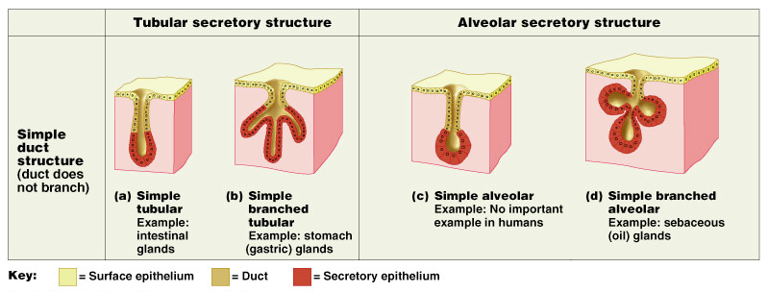
Structural Classification of Multicellular Exocrine Glands
Figure 4.3a-d

Slide 24
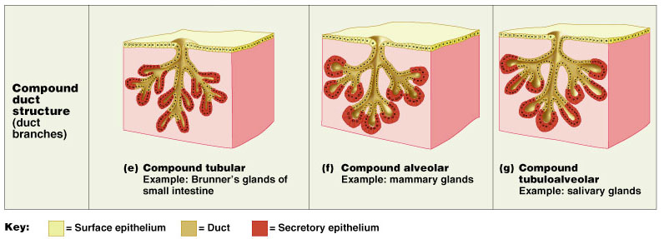
Structural Classification of Multicellular Exocrine Glands
Figure 4.3e-g

Slide 25
4
Tissue: The Living Fabric
Part B

Slide 26
Modes of Secretion
Merocrine – products are secreted by exocytosis (e.g., pancreas, sweat, and salivary glands)
Holocrine – products are secreted by the rupture of gland cells (e.g., sebaceous glands)

Slide 27
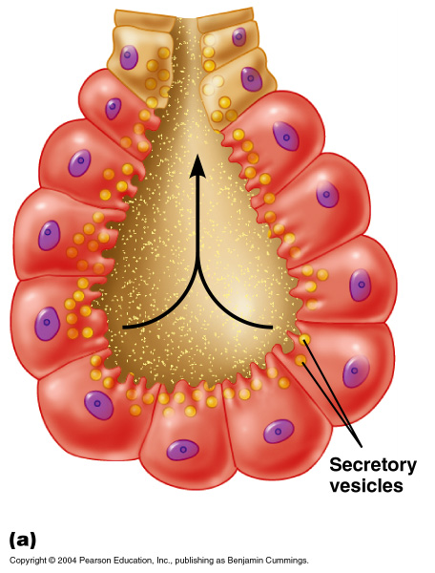
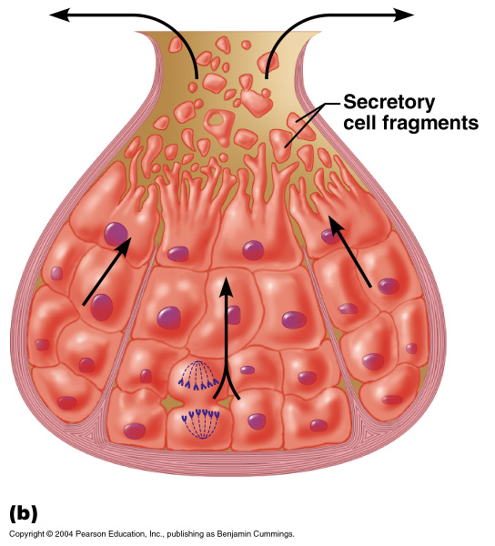
Modes of Secretion
Figure 4.4

Slide 28
Connective Tissue
Found throughout the body; most abundant and widely distributed in primary tissues
Connective tissue proper
Cartilage
Bone
Blood

Slide 29
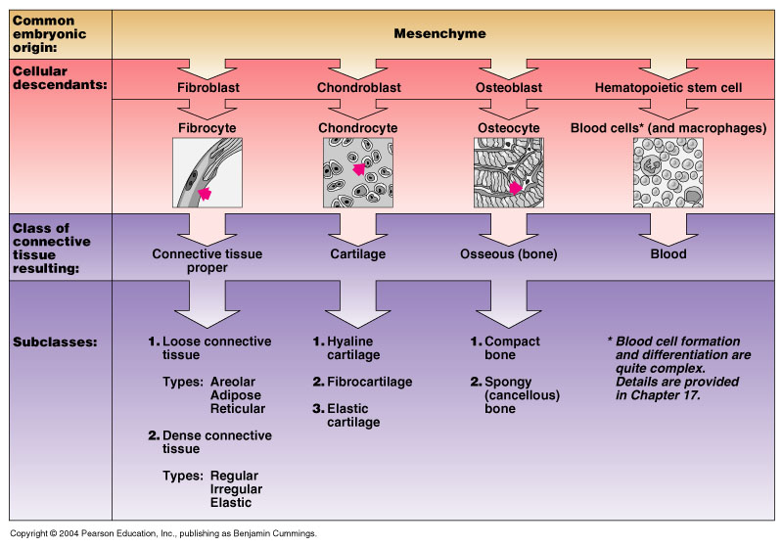
Connective Tissue
Figure 4.5

Slide 30
Functions of Connective Tissue
Binding and support
Protection
Insulation
Transportation

Slide 31
Characteristics of Connective Tissue
Connective tissues have:
Mesenchyme as their common tissue of origin
Varying degrees of vascularity
Nonliving extracellular matrix, consisting of ground substance and fibers

Slide 32
Structural Elements of Connective Tissue
Ground substance – unstructured material that fills the space between cells
Fibers – collagen, elastic, or reticular
Cells – fibroblasts, chondroblasts, osteoblasts, and hematopoietic stem cells

Slide 33
Ground Substance
Interstitial (tissue) fluid
Adhesion proteins – fibronectin and laminin
Proteoglycans – glycosaminoglycans (GAGs)
Functions as a molecular sieve through which nutrients diffuse between blood capillaries and cells

Slide 34
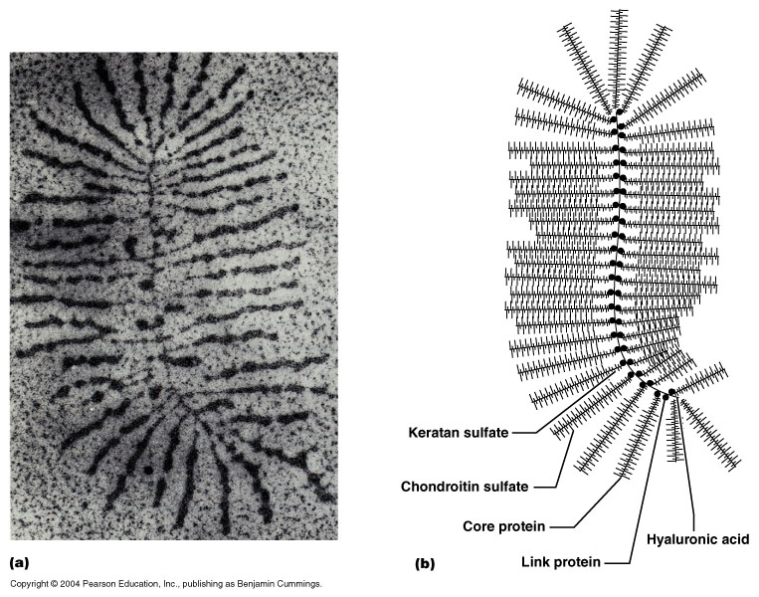
Ground Substance: Proteoglycan Structure
Figure 4.6b

Slide 35
Fibers
Collagen – tough; provides high tensile strength
Elastic – long, thin fibers that allow for stretch
Reticular – branched collagenous fibers that form delicate networks

Slide 36
Cells
Fibroblasts – connective tissue proper
Chondroblasts – cartilage
Osteoblasts – bone
Hematopoietic stem cells – blood
White blood cells, plasma cells, macrophages, and mast cells

Slide 37
Connective Tissue: Embryonic
Mesenchyme – embryonic connective tissue
Gel-like ground substance with fibers and star-shaped mesenchymal cells
Gives rise to all other connective tissues
Found in the embryo

Slide 38
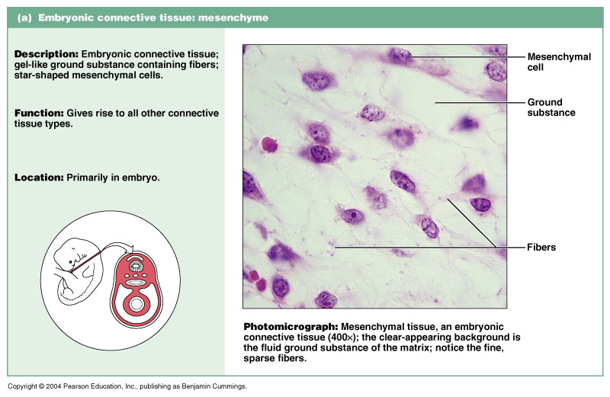
Connective Tissue: Embryonic
Figure 4.8a

Slide 39
Connective Tissue Proper: Loose
Areolar connective tissue
Gel-like matrix with all three connective tissue fibers
Fibroblasts, macrophages, mast cells, and some white blood cells
Wraps and cushions organs
Widely distributed throughout the body

Slide 40
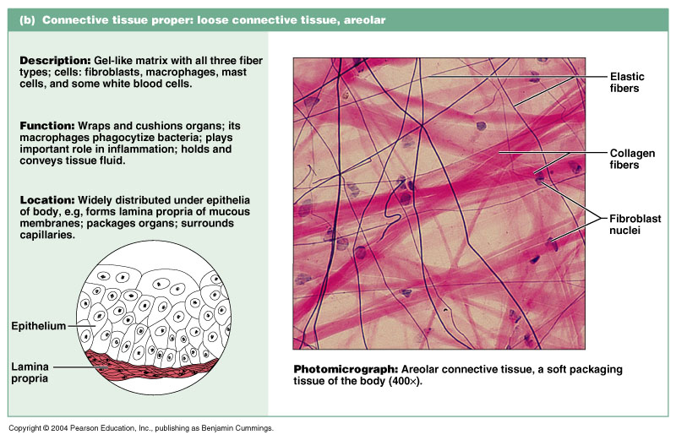
Connective Tissue Proper: Loose
Figure 4.8b

Slide 41
Connective Tissue Proper: Loose
Adipose connective tissue
Matrix similar to areolar connective tissue with closely packed adipocytes
Reserves food stores, insulates against heat loss, and supports and protects
Found under skin, around kidneys, within abdomen, and in breasts
Local fat deposits serve nutrient needs of highly active organs

Slide 42
Connective Tissue Proper: Loose
Figure 4.8c

Slide 43
Connective Tissue Proper: Loose
Reticular connective tissue
Loose ground substance with reticular fibers
Reticular cells lie in a fiber network
Forms a soft internal skeleton, or stroma, that supports other cell types
Found in lymph nodes, bone marrow, and the spleen

Slide 44
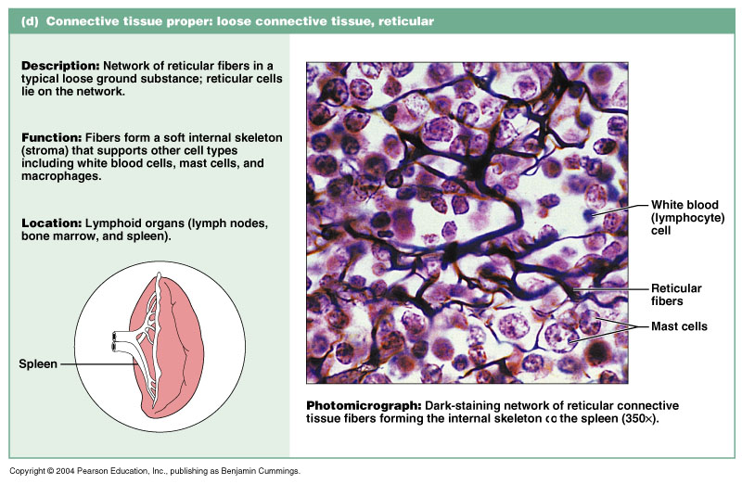
Connective Tissue Proper: Loose
Figure 4.8d

Slide 45
Connective Tissue Proper: Dense Regular
Parallel collagen fibers with a few elastic fibers
Major cell type is fibroblasts
Attaches muscles to bone or to other muscles, and bone to bone
Found in tendons, ligaments, and aponeuroses

Slide 46
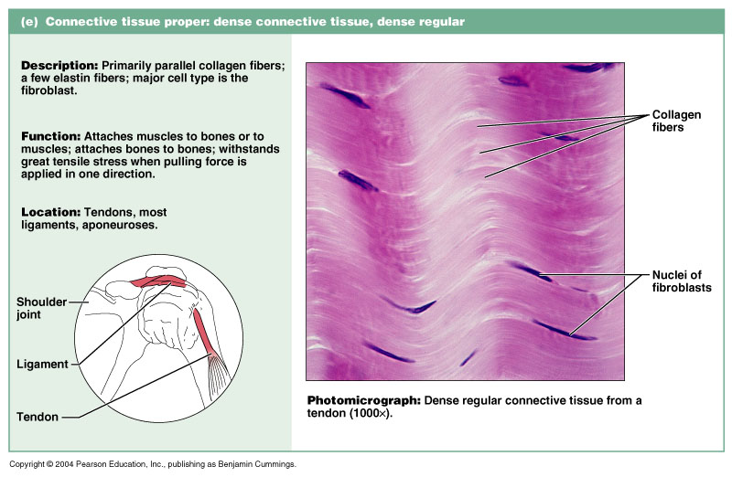
Connective Tissue Proper: Dense Regular
Figure 4.8e

Slide 47
Connective Tissue Proper: Dense Irregular
Irregularly arranged collagen fibers with some elastic fibers
Major cell type is fibroblasts
Withstands tension in many directions providing structural strength
Found in the dermis, submucosa of the digestive tract, and fibrous organ capsules

Slide 48
Connective Tissue Proper: Dense Regular
Figure 4.8f

Slide 49
4
Tissue: The Living Fabric
Part C

Slide 50
Connective Tissue: Cartilage
Hyaline cartilage
Amorphous, firm matrix with imperceptible network of collagen fibers
Chondrocytes lie in lacunae
Supports, reinforces, cushions, and resists compression
Forms the costal cartilage
Found in embryonic skeleton, the end of long bones, nose, trachea, and larynx

Slide 51
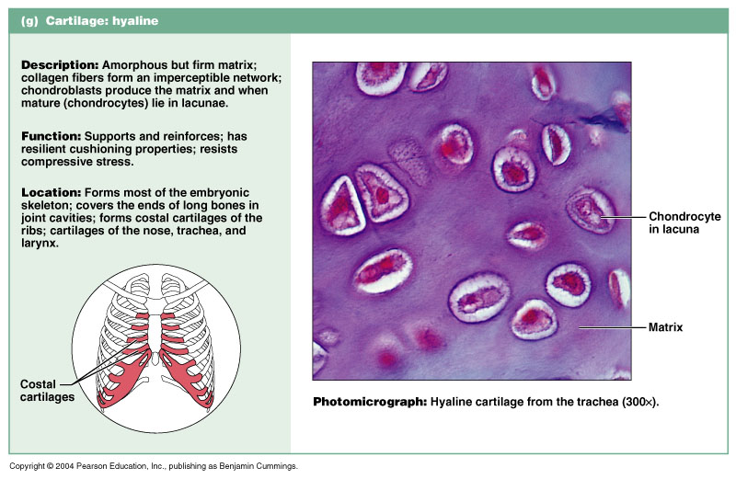
Connective Tissue: Hyaline Cartilage
Figure 4.8g

Slide 52
Connective Tissue: Elastic Cartilage
Similar to hyaline cartilage but with more elastic fibers
Maintains shape and structure while allowing flexibility
Supports external ear (pinna) and the epiglottis

Slide 53
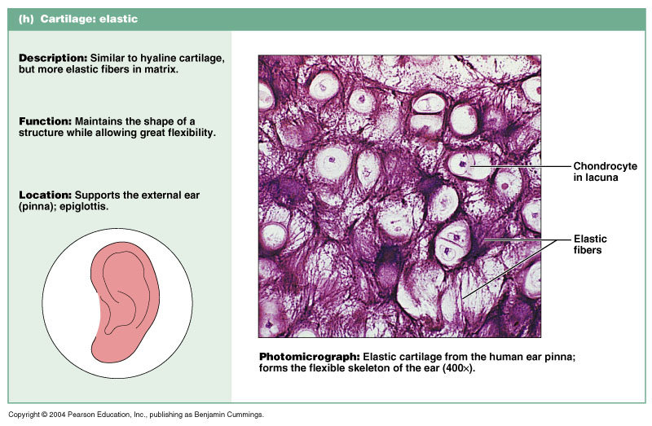
Connective Tissue: Elastic Cartilage
Similar to hyaline cartilage but with more elastic fibers
Maintains shape and structure while allowing flexibility
Supports external ear (pinna) and the epiglottis
Figure 4.8h

Slide 54
Connective Tissue: Fibrocartilage Cartilage
Matrix similar to hyaline cartilage but less firm with thick collagen fibers
Provides tensile strength and absorbs compression shock
Found in intervertebral discs (shock absorbent), the pubic symphysis, and in discs of the knee joint

Slide 55
Connective Tissue: Fibrocartilage Cartilage
Matrix similar to hyaline cartilage but less firm with thick collagen fibers
Provides tensile strength and absorbs compression shock
Found in intervertebral discs, the pubic symphysis, and in discs of the knee joint
Figure 4.8i

Slide 56
Connective Tissue: Bone (Osseous Tissue)
Hard, calcified matrix with collagen fibers found in bone
Osteocytes are found in lacunae and are well vascularized
Supports, protects, and provides levers for muscular action
Stores calcium, minerals, and fat
Marrow inside bones is the site of hematopoiesis

Slide 57
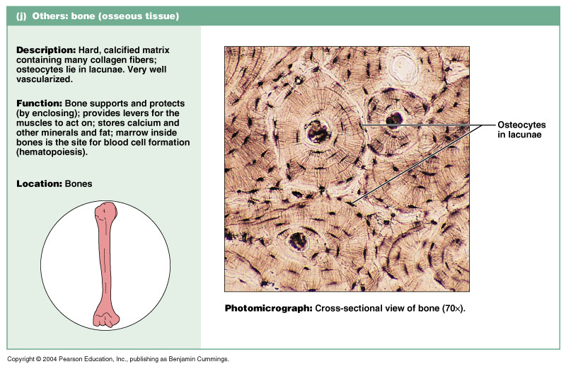
Connective Tissue: Bone (Osseous Tissue)
Figure 4.8j

Slide 58
Connective Tissue: Blood
Red and white cells in a fluid matrix (plasma)
Contained within blood vessels
Functions in the transport of respiratory gases, nutrients, and wastes

Slide 59
Connective Tissue: Blood
Figure 4.8k

Slide 60
Epithelial Membranes
Cutaneous – skin
Figure 4.9a

Slide 61
Epithelial Membranes
Mucous – lines body cavities open to the exterior (e.g., digestive and respiratory tracts)
Serous – moist membranes found in closed ventral body cavity
Figure 4.9b

Slide 62
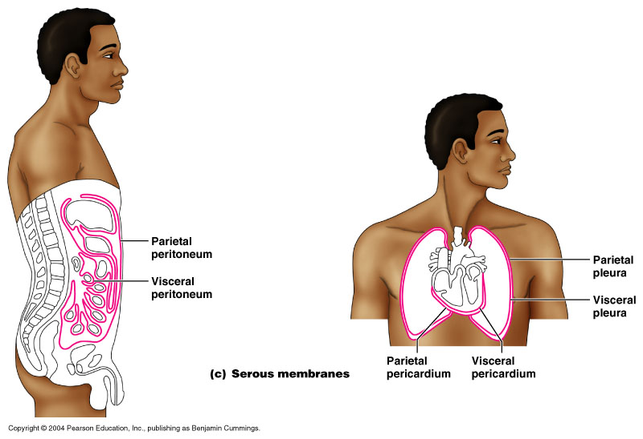
Epithelial Membranes
Figure 4.9c

Slide 63
4
Tissue: The Living Fabric
Part D

Slide 64
Nervous Tissue
Branched neurons with long cellular processes and support cells
Transmits electrical signals from sensory receptors to effectors
Found in the brain, spinal cord, and peripheral nerves
PLAY
InterActive Physiology®: Nervous System I: Anatomy Review

Slide 65
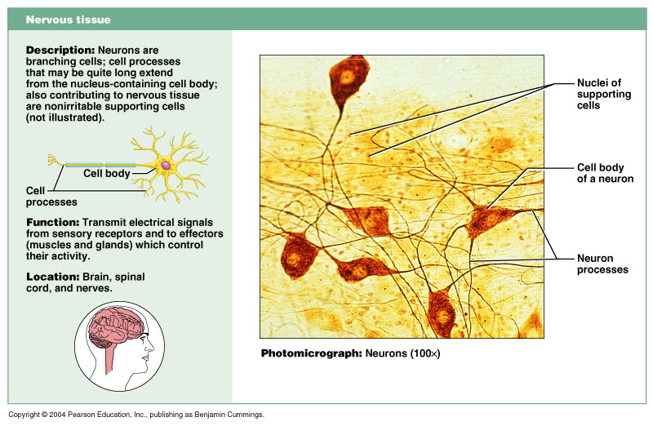
Nervous Tissue
Figure 4.10

Slide 66
Muscle Tissue: Skeletal
Long, cylindrical, multinucleate cells with obvious striations
Initiates and controls voluntary movement
Found in skeletal muscles that attach to bones or skin

Slide 67
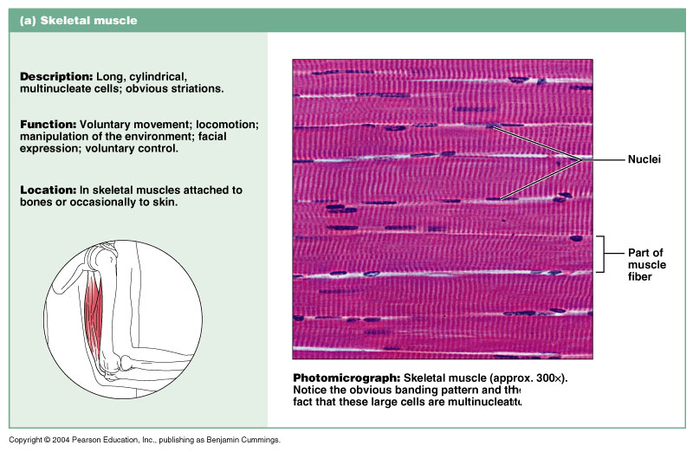
Muscle Tissue: Skeletal
Long, cylindrical, multinucleate cells with obvious striations
Initiates and controls voluntary movement
Found in skeletal muscles that attach to bones or skin
Figure 4.11a

Slide 68
Muscle Tissue: Cardiac
Branching, striated, uninucleate cells interlocking at intercalated discs
Propels blood into the circulation
Found in the walls of the heart

Slide 69
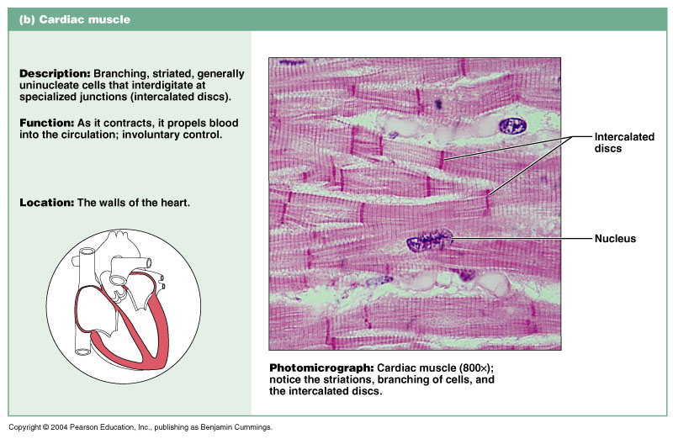
Muscle Tissue: Cardiac
Branching, striated, uninucleate cells interdigitating at intercalated discs
Propels blood into the circulation
Found in the walls of the heart
Figure 4.11b

Slide 70
Muscle Tissue: Smooth
Sheets of spindle-shaped cells with central nuclei that have no striations
Propels substances along internal passageways (i.e., peristalsis)
Found in the walls of hollow organs

Slide 71
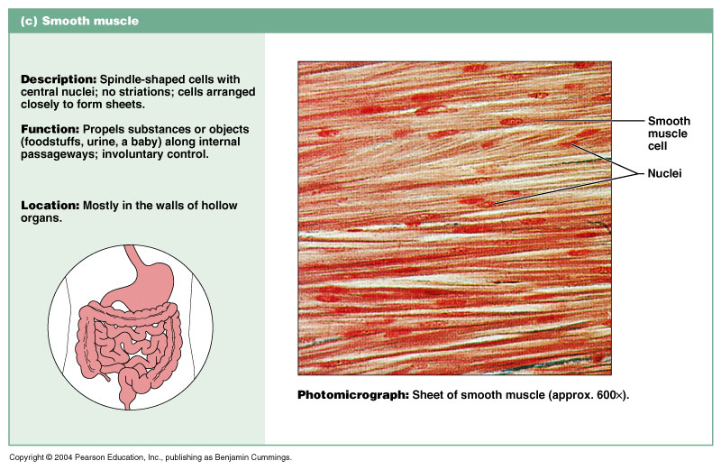
Muscle Tissue: Smooth
Figure 4.11c

Slide 72
Tissue Trauma
Causes inflammation, characterized by:
Dilation of blood vessels
Increase in vessel permeability
Redness, heat, swelling, and pain

Slide 73
Tissue Repair
Organization and restored blood supply
The blood clot is replaced with granulation tissue
Regeneration and fibrosis
Surface epithelium regenerates and the scab detaches
Figure 4.12a

Slide 74
Tissue Repair
Fibrous tissue matures and begins to resemble the adjacent tissue
Figure 4.12b

Slide 75
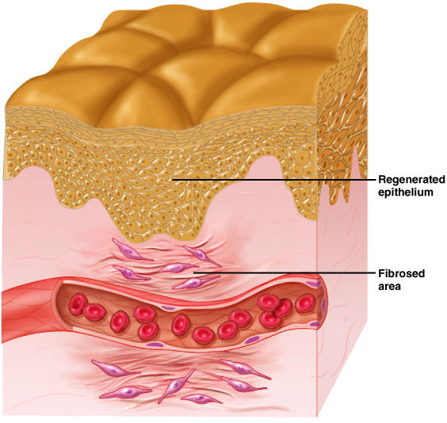
Tissue Repair
Results in a fully regenerated epithelium with underlying scar tissue
Figure 4.12c

Slide 76
Developmental Aspects
Primary germ layers: ectoderm, mesoderm, and endoderm
Three layers of cells formed early in embryonic development
Specialize to form the four primary tissues
Nerve tissue arises from ectoderm

Slide 77
Developmental Aspects
Muscle, connective tissue, endothelium, and mesothelium arise from mesoderm
Most mucosae arise from endoderm
Epithelial tissues arise from all three germ layers

Slide 78
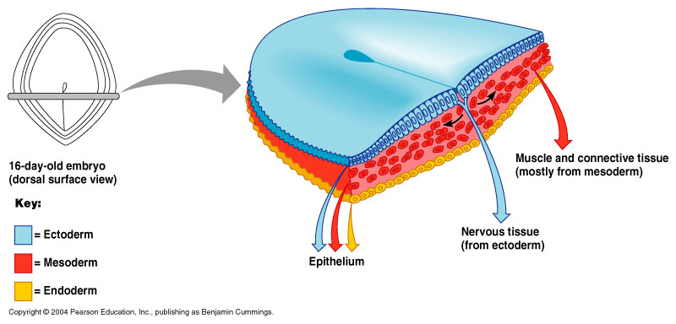
Developmental Aspects
Figure 4.13

