Slide 1
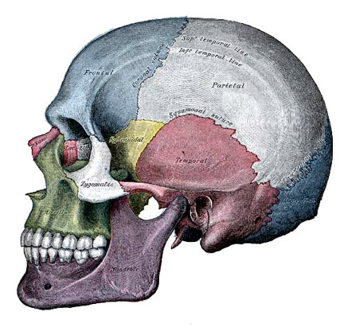
Human Anatomy and Physiology I
Chapter 1: Introduction to Human Anatomy and Physiology.

Slide 2
Overview of Human Anatomy and Physiology
Anatomy – the study of the structure of the body and the relationships of the various parts of the body
Gross or macroscopic (visible structures)
Microscopic (cytology, histology)
Developmental – structural changes over time (embryology)
Physiology – the study of the functions of the parts of the body, includes specific organ systems and molecular and cellular levels (neurophysiology, cardiovascular physiology, electrophysiology)

Slide 3
Introduction:
The early students of anatomy and physiology were most likely concerned with treating illnesses and injuries.
Early healers relied on superstitions and magic.

Slide 4
Later, herbs were used to treat certain ailments.
Eventually, after much controversy, the study of medicine with standardized terms in Greek and Latin began.

Slide 5
Levels of Structural Organization
Chemical – atoms combine to form molecules
Cellular – molecules interact to make up cells
Tissue – cells are grouped into tissue
Organ – tissues compose organs
Organ system – organs function together to form organ systems
Organism (individual) – made up of the organ systems

Slide 6
Basic Structures of the Human Body
Tissue – A group of similar cells that performs a specific function
Organ – A structure consisting of a group of tissues with a specialized function
Organ System – Organs working together to allow the body to perform a function.

Slide 7
Organ Systems
Integumentary system
Forms the external body covering
Composed of skin, sweat glands, oil glands, hair, and nails
Protects deep tissues from injury and synthesizes vitamin D

Slide 8
Organ Systems of the Body
Skeletal system
Composed of bone, cartilage, and ligaments
Protects and supports body organs
Provides the framework for muscles
Site of blood cell formation
Stores minerals

Slide 9
Organ Systems of the Body
Muscular system
Composed of muscles and tendons
Allows manipulation of the environment, locomotion, and facial expression
Maintains posture
Produces heat

Slide 10
Organ Systems of the Body
Nervous system
Integrates and coordinates body functions
Composed of the brain, spinal column, and nerves
Is the fast-acting control system of the body
Responds to stimuli by activating muscles and glands

Slide 11
Organ Systems of the Body
Endocrine System
Integrates and coordinates body functions
Includes all glands that secrete chemical messengers, also called hormones
Hormones alter the metabolism of target cells
Examples of organs of the ES are the pituitary, thyroid, parathyroid, adrenal glands, pancreas, ovaries, testes, pineal gland, and thymus gland

Slide 12
Organ Systems of the Body
Cardiovascular system
Composed of the heart and blood vessels
The heart pumps blood
The blood vessels transport blood throughout the body

Slide 13
Organ Systems of the Body
Lymphatic system
Composed of red bone marrow, thymus, spleen, lymph nodes, and lymphatic vessels
Picks up fluid leaked from blood vessels and returns it to blood
Disposes of debris in the lymphatic stream
Houses white blood cells involved with immunity

Slide 14
Organ Systems of the Body
Respiratory system
Composed of the nasal cavity, pharynx, trachea, bronchi, and lungs
Keeps blood supplied with oxygen and removes carbon dioxide

Slide 15
Organ Systems of the Body
Digestive system
Composed of the oral cavity, esophagus, stomach, small intestine, large intestine, rectum, anus, and liver
Breaks down food into absorbable units that enter the blood
Eliminates indigestible foodstuffs as feces

Slide 16
Organ Systems of the Body
Urinary system
Composed of kidneys, ureters, urinary bladder, and urethra
Eliminates nitrogenous wastes from the body
Regulates water, electrolyte, and pH balance of the blood

Slide 17
Organ Systems of the Body
Male reproductive system
Composed of prostate gland, penis, testes, scrotum, and ductus deferens
Main function is the production of offspring
Testes produce sperm and male sex hormones
Ducts and glands deliver sperm to the female reproductive tract

Slide 18
Organ Systems of the Body
Female reproductive system
Composed of mammary glands, ovaries, uterine tubes, uterus, and vagina
Main function is the production of offspring
Ovaries produce eggs and female sex hormones
Remaining structures serve as sites for fertilization and development of the fetus
Mammary glands produce milk to nourish the newborn

Slide 19
Organ System Interrelationships
The integumentary system protects the body from the external environment
Digestive and respiratory systems, in contact with the external environment, take in nutrients and oxygen

Slide 20
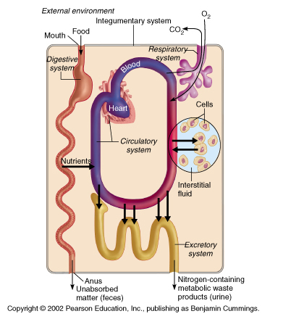
Organ System Interrelationships
Nutrients and oxygen are distributed by the blood
Metabolic wastes are eliminated by the urinary and respiratory systems

Slide 21
Copyright©The McGraw-Hill Companies, Inc. Permission required for reproduction or display.
Characteristics of life include:
1. Movement (internal or gross)
2. Responsiveness (reaction to internal or external change)
3. Growth (increase in size without change in shape)
4. Reproduction (new organisms or new cells)
5. Respiration (use of oxygen; removal of CO₂)

Slide 22
6. Digestion (breakdown of food into simpler forms)
7. Absorption (movement of substances through membranes and into fluids)
8. Circulation (movement within body fluids)
9. Assimilation (changing nutrients into chemically different forms)
10. Excretion (removal of metabolic wastes)
The total of all the chemical reactions that are continuously at work to maintain these characteristics constitutes metabolism.

Slide 23
Metabolism-side note
Metabolism: A broad term used for all the chemical reactions that occur within cells of the body
Catabolism - breaking down substances into simpler components
Anabolism – synthesizing more complex substances or structures from simpler substances

Slide 24
Homeostasis
B. Homeostasis:
a. Maintenance of a stable internal environment is called homeostasis. Homeostasis is regulated through control systems that have receptors, a set point, and effectors in common. Examples include:
b. Homeostatic mechanisms regulate body temperature in a manner similar to the functioning of a home heating thermostat.
c. Another homeostatic mechanism employs pressure- sensitive receptors to regulate blood pressure.

Slide 25
Homeostatic Control Mechanisms
Variable – the factor or event being regulated
Receptor monitors the environment and responds to changes (stimuli)
Control center determines the set point at which the variable is maintained
Effector provides the means to respond to the stimulus

Slide 26
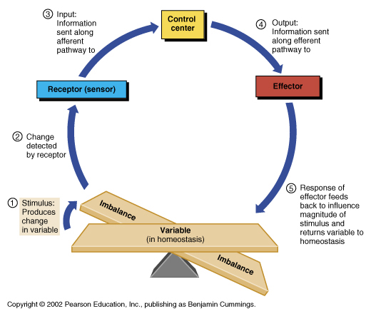
Homeostatic Control Mechanisms

Slide 27
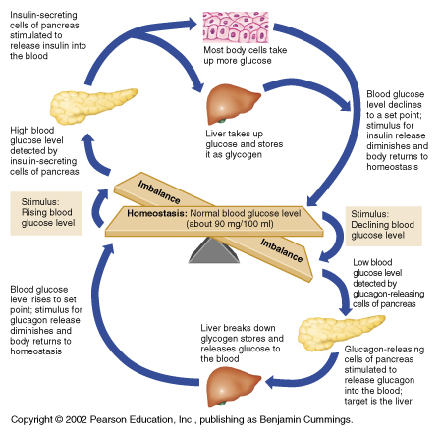
Negative Feedback
In negative feedback systems, the output “turns down” or “shuts off” the original stimulus
Example: Regulation of blood glucose levels

Slide 28
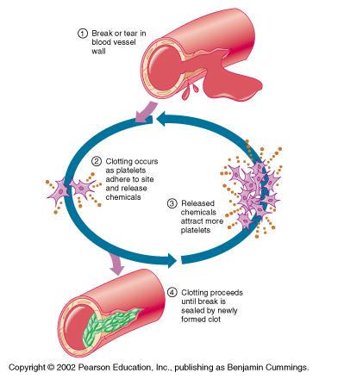
Positive Feedback
In positive feedback systems, the output enhances or “turns up” the original stimulus
Examples: Regulation of blood clotting, Uterine contractions during labor.

Slide 29
Levels of Structural Organization

Slide 30
C. Levels of Organization
The human body is the sum of its parts and these parts can be studied at a variety of levels of organization.
1. Atoms are the simplest level.
2. Two or more atoms comprise a molecule.
3. Macromolecules are large, biologically important molecules inside cells.
4. Organelles are aggregates of macromolecules used to carry out a specific function in the cell.

Slide 31
5. Cells are the basic living unit.
6. Tissues are groups of cells functioning together.
7. Groups of tissues form organs.
8. Groups of organs function together as organ systems.
9. Organ systems functioning together make up an organism.

Slide 32
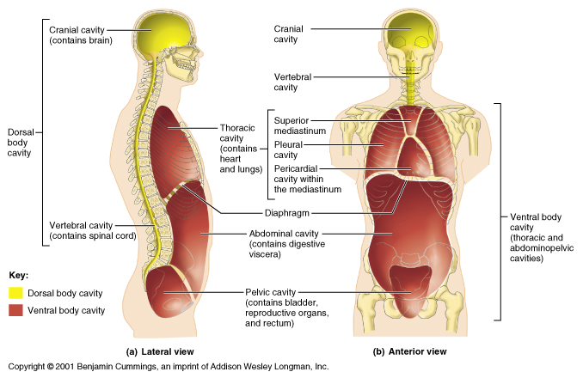
Body Cavities

Slide 33
Body Cavities
Thoracic cavity is subdivided into pleural cavities, the mediastinum, and the pericardial cavity
Pleural cavities – each houses a lung
Mediastinum – contains the pericardial cavity, and surrounds the remaining thoracic organs
Pericardial – encloses the heart

Slide 34
Body Cavities-side note
Dorsal cavity protects the nervous system, and is divided into two subdivisions
Cranial cavity is within the skull and encases the brain
Vertebral cavity runs within the vertebral column and encases the spinal cord
Ventral cavity houses the internal organs (viscera), and is divided into two subdivisions: thoracic and abdominopelvic

Slide 35
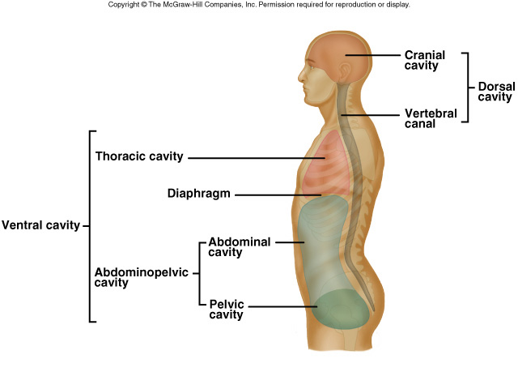
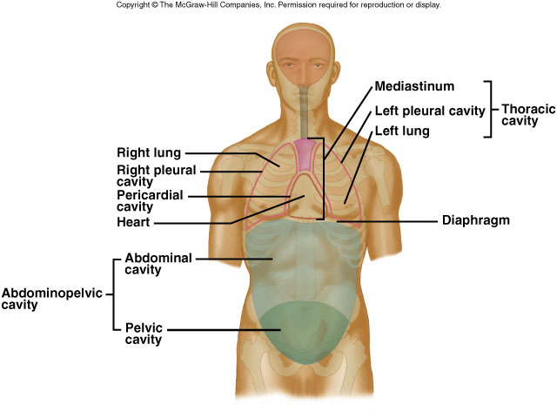
D. Organization of the Human Body
Major features of the human body include its cavities, membranes, and organ systems.

Slide 36
Copyright©The McGraw-Hill Companies, Inc. Permission required for reproduction or display.
a. Body Cavities:
The body can be divided into an appendicular portion (upper and lower limbs) and an axial portion (head, neck, and trunk), which includes a dorsal and a ventral cavity. Organs within these cavities are called viscera.

Slide 37
Anatomical Position
Body erect,
feet slightly apart,
palms facing forward,
thumbs point away
from the body

Slide 38
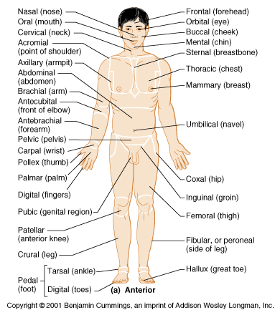
Regional Terms
Axial – head, neck, and trunk
Appendicular – appendages or limbs
Specific regional terminology

Slide 39
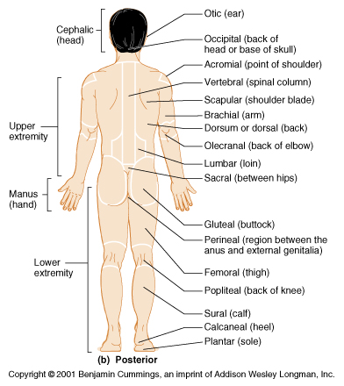
Regional Terms

Slide 40
Body cavity continued…
i. The dorsal cavity can be divided into the cranial cavity and vertebral canal.
ii. The ventral cavity is made up of a thoracic cavity and an abdominopelvic cavity, separated by the diaphragm.
a. The mediastinum divides the thorax into right and left halves.
b. The abdominopelvic cavity can be divided into the abdominal cavity and the pelvic cavity.
iii. Smaller cavities within the head include the oral cavity, nasal cavity, orbital cavities, and middle ear cavities.

Slide 41
Copyright©The McGraw-Hill Companies, Inc. Permission required for reproduction or display.
b.Thoracic and Abdominopelvic Membranes:
1. The thoracic cavity is lined with pleura; the parietal pleura lines the cavities while the visceral pleura covers the lungs. A thin layer of serous fluid separates the two layers.
2. The heart is surrounded by pericardium. The visceral pericardium covers the heart and the parietal pericardium makes up an outer sac. Serous fluid separates the two layers.
3. Peritoneum lines the abdominopelvic cavity; a parietal peritoneum lines the wall while visceral peritoneum covers the organs.

Slide 42
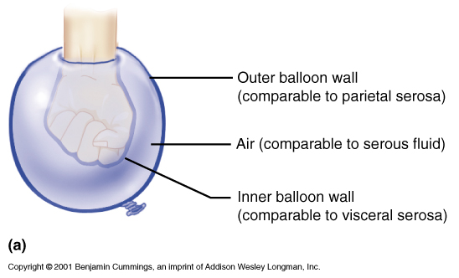
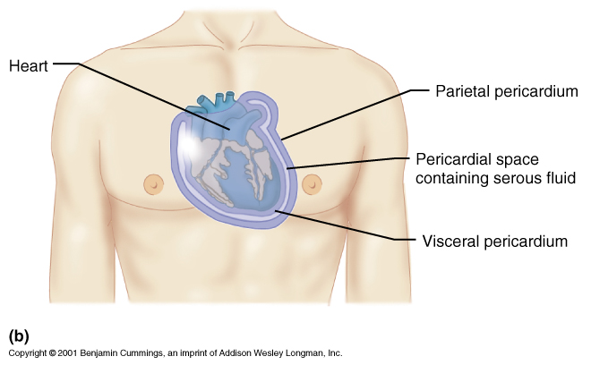
Ventral Body Cavity Membranes
Parietal serosa covering the body walls
Visceral serosa covering the internal organs
Serous fluid separates the serosae

Slide 43
Ventral Body Cavity Membranes
Parietal Pleura - pleura lining the inner chest walls and covering the diaphragm
Visceral Pleura - pleura covering the lungs
Peritoneum – the serous membrane lining the abdominal cavity and covering most of the viscera

Slide 44
Nomenclature for Serous Membranes
Pleura - the thin serous membrane around the lungs and inner walls of the chest
Peritoneum – the serous membrane lining the abdominal cavity and covering most of the viscera
Endocardium - the membrane that lines the cavities of the heart and forms part of the heart valves
Pericardium - a double-layered serous membrane that surrounds the heart
Visceral Pericardium (epicardium) - the innermost of the two layers of the pericardium
Parietal Pericardium - the tough outermost layer of the pericardium that is attached to the diaphragm and the sternum

Slide 45
Copyright©The McGraw-Hill Companies, Inc. Permission required for reproduction or display.
III. Organ Systems:
A. Body Covering
a. The integumentary system, including skin, hair, nails, and various glands, covers the body, senses changes outside the body, and helps regulate body temperature.

Slide 46
Copyright©The McGraw-Hill Companies, Inc. Permission required for reproduction or display.
B. Support and Movement
a. The skeletal system is made up of bones and ligaments. It supports, protects, provides frameworks, stores inorganic salts, and houses blood-forming tissues.
b. The muscular system consists of the muscles that provide body movement, posture, and body heat.

Slide 47
Copyright©The McGraw-Hill Companies, Inc. Permission required for reproduction or display.
C. Integration and Coordination
a. The nervous system consists of the brain, spinal cord, nerves, and sense organs. It integrates incoming information from receptors and sends impulses to muscles and glands.
b. The endocrine system, including all of the glands that secrete hormones, helps to integrate metabolic functions.

Slide 48
Copyright©The McGraw-Hill Companies, Inc. Permission required for reproduction or display.
D. Transport
a. The cardiovascular system, made up of the heart and blood vessels, distributes oxygen and nutrients throughout the body while removing wastes from the cells.
b. The lymphatic system, consisting of lymphatic vessels, lymph nodes, thymus, and spleen, drains excess tissue fluid and includes cells of immunity.

Slide 49
Copyright©The McGraw-Hill Companies, Inc. Permission required for reproduction or display.
E. Absorption and Excretion
a. The digestive system is made up of the mouth, esophagus, stomach, intestines, and accessory organs. It receives, breaks down, and absorbs nutrients.

Slide 50
Copyright©The McGraw-Hill Companies, Inc. Permission required for reproduction or display.
b. The respiratory system exchanges gases between the blood and air and is made up of the lungs and passageways.
c. The urinary system, consisting of the kidneys, ureters, bladder, and urethra, removes wastes from the blood and helps to maintain water and electrolyte balance.

Slide 51
Copyright©The McGraw-Hill Companies, Inc. Permission required for reproduction or display.
F. Reproduction
a. The reproductive system produces new organisms.
i. The male reproductive system consists of the testes, accessory organs, and vessels that conduct sperm to the penis.
ii. The female reproductive system consists of ovaries, uterine tubes, uterus, vagina, and external genitalia. The female reproductive system also houses the developing offspring.

Slide 52
Copyright©The McGraw-Hill Companies, Inc. Permission required for reproduction or display.
Anatomical Terminology
Relative Positions:
1. Terms of relative position are used to describe the location of a part relative to another part.
2. Terms of relative position include: superior, inferior, anterior, posterior, medial, lateral, proximal, distal, superficial (peripheral), and deep.

Slide 53
Directional Terms
Superior (Cranial) and Inferior (Caudal) – toward and away from the head or upper part of a structure - above and below-
Anterior (Ventral) and Posterior (Dorsal) – toward the front and back of the body - in front of and behind-
Medial, Lateral, and Intermediate – toward the midline, away from the midline, and between a more medial and lateral structure

Slide 54
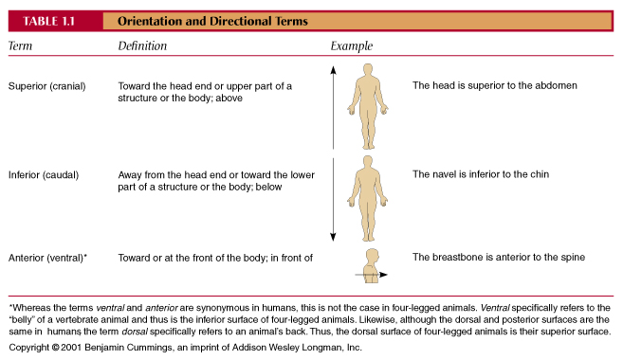
Directional Terms

Slide 55
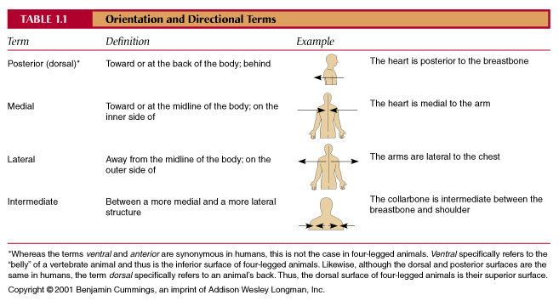
Directional Terms

Slide 56
Directional Terms
Proximal and Distal – closer to and farther from the origin of the body part or the point of attachment of a limb
Superficial (External) and Deep (Internal) – toward and away from the body surface

Slide 57
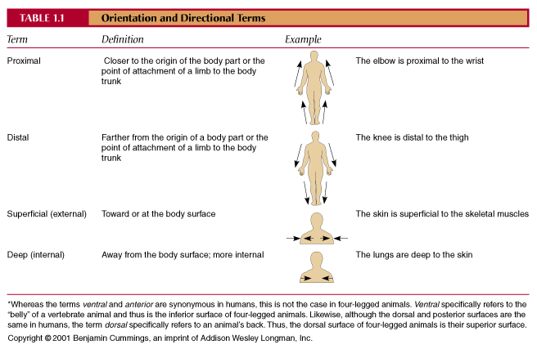
Directional Terms

Slide 58
Copyright©The McGraw-Hill Companies, Inc. Permission required for reproduction or display.
Body Sections:
1. A sagittal section divides the body into right and left portions.
2. A transverse section divides the body into superior and inferior portions. It is often
called a “cross section”.
3. A coronal section divides the body into anterior and posterior sections.

Slide 59
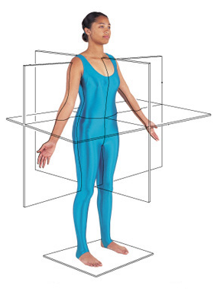
Body Planes
Frontal or Coronal Plane
←Transverse Plane
← Sagittal Plane

Slide 60
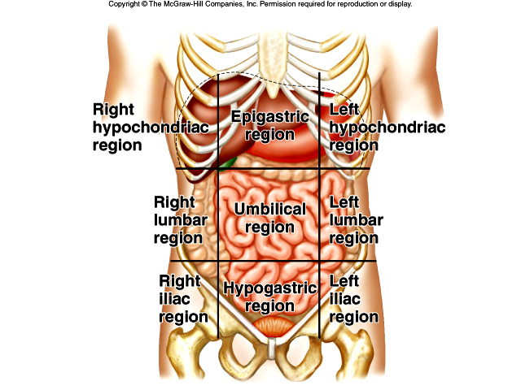
Abdominopelvic Regions

Slide 61
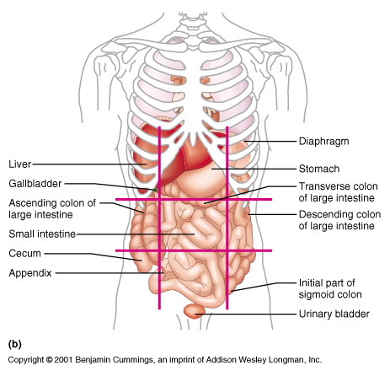
Abdominopelvic Regions

