Slide 1
Chapter 17
Segmented Worms

Slide 2
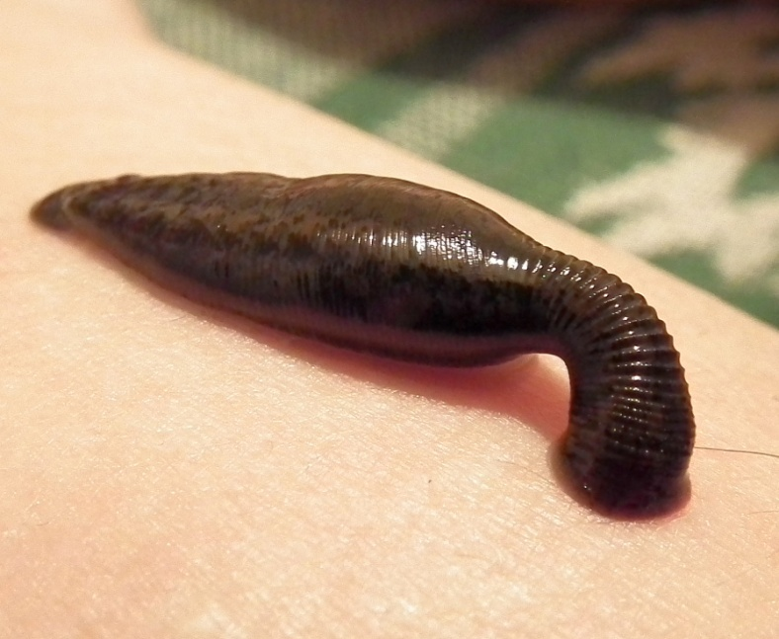
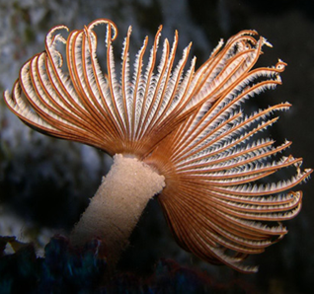
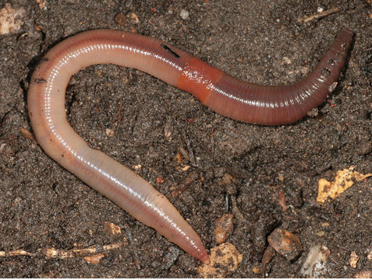
Outline: Things to Know!
Intro to segmented worms
(P. Annelida)
Body plan
C. Polychaeta (feather-duster worms, clamworms, scaleworms, lungworms)
C. Oligochaeta (earthworms)
earthworm
form/func.
C. Hirudinea
(leeches)
form/func.

Slide 3
Evolutionary Significance of Metamerism
Origins of coelom and metamerism
coelom advantage = hydrostatic skeleton
coelomic fluid serves as circulatory fluid (food/waste)
↓ need for wide distribution of flame cells
store gametes for timed release to ↑ fertilization
require nervous and endocrine control
metamerism ↑ burrowing efficiency
allows contraction of muscles in 1 part of body at time
independent mvmt of indiv. segments
allows ↑ control
↑ structural/func. complexity
regeneration in some

Slide 4
General Annelid Body Plan
Hydrostatic skeleton (fluid in coelomic cavity)
Complete digestive system
Respiratory gas exchange through skin, gills or parapodia
Excretory system-pair of nephridia for each segment (kidney like structure)

Slide 5
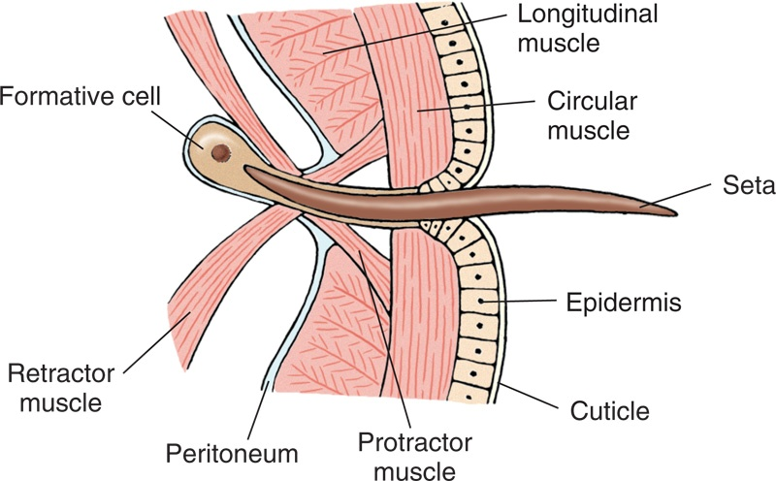
Phylum Annelida
Chitinous Setae present on segments, help anchor body during locomotion to prevent body slipping (absent in leeches)
True coelom which is well developed and divided by septa (absent in leeches)
Closed circulatory system

Slide 6
Circulatory Systems- open vs closed

Slide 7
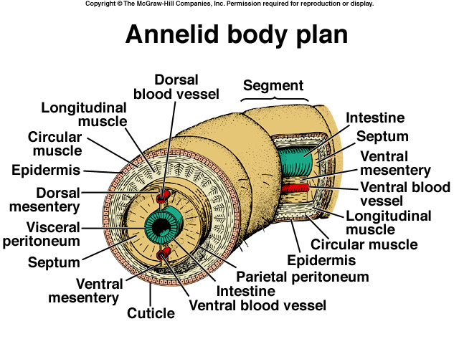

Slide 8
Nervous system with double ventral nerve cord and a pair of ganglia with lateral nerves at each segment. “Brain” a pair of dorsal cerebral ganglia with connections to cord.
Sensory system-tactile organs, taste buds, photoreceptors, and eyes with lenses for some.
Reproduction: Hermaphroditic or separate sexes, larva if present-trocophore type.

Slide 9
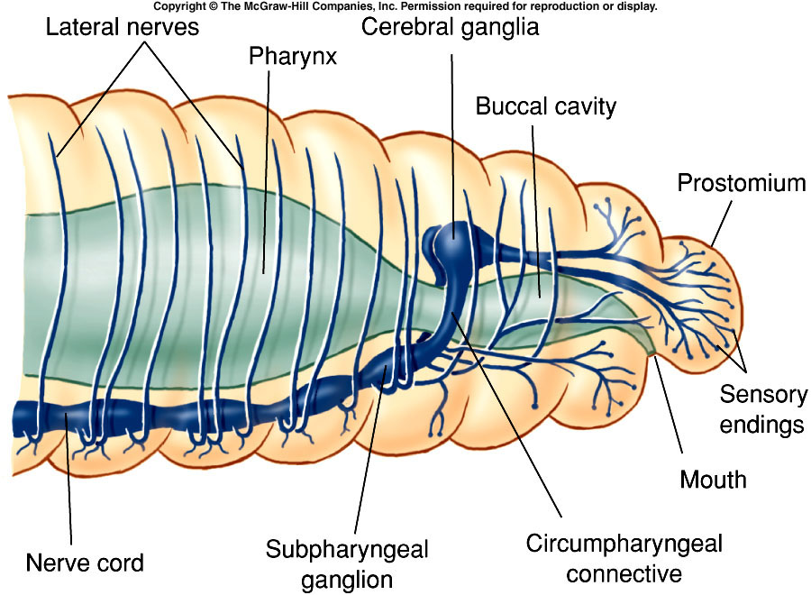
Notes:
Fig. 17.15

Slide 10
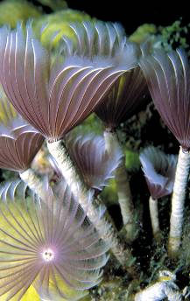
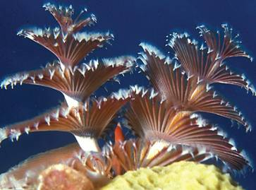
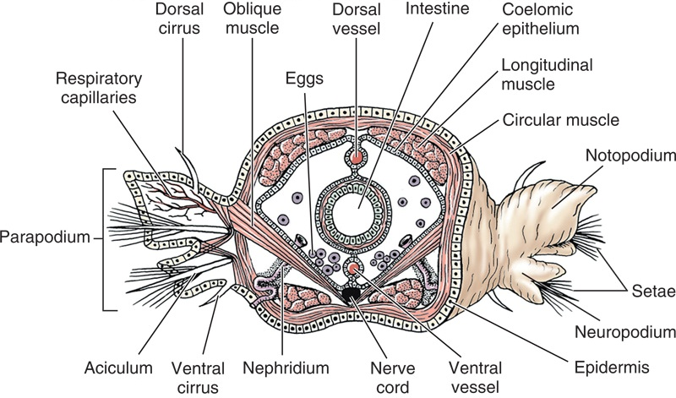
P. Annelida: C. Polychaeta
Characteristics
feather-duster/fireworm/scaleworm/lungworms
+10,000 sp.
mostly marine, some fresh
1mm - 3m, colorful/dull
sedentary sp. live in crevices/tubes
free-moving/burrowing/crawling

Slide 11
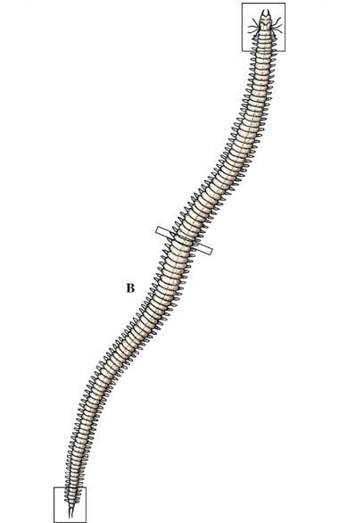
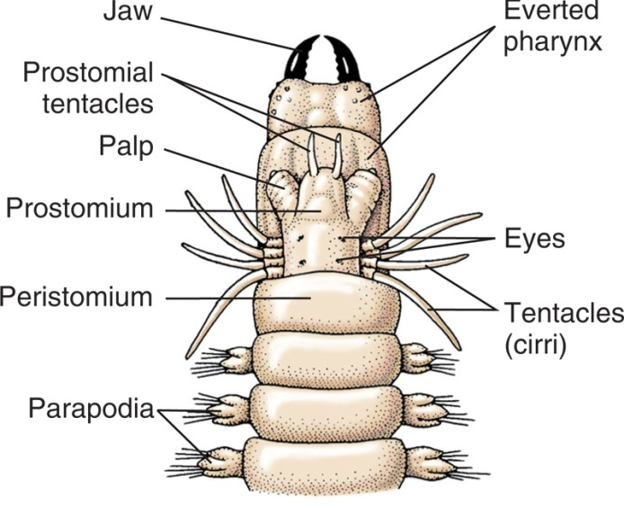
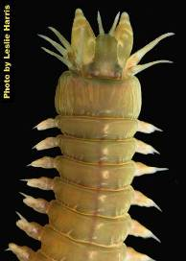
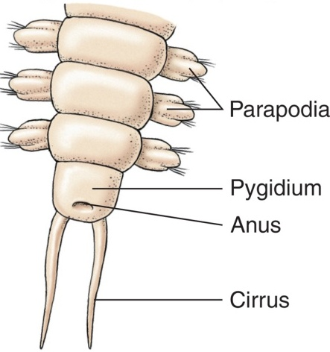
P. Annelida: C. Polychaeta
distinct head w/ eyes/tentacles
lateral appendages (parapodia) on most segments
have parapodia that have many
blood vessels and function as gills.
w/ tufts of many setae
dioecious
asexual budding
trochophore larvae
↑ specialization of sensory organs than clitellates
Mostly marine

Slide 12
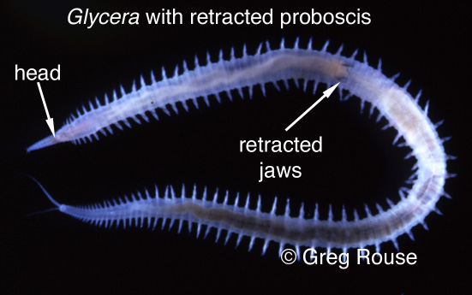
Class Polychaeta
Each segment of a polychaete (meaning “many setae,” for the bristles on each segment) has a pair of paddle like or ridge like structures called parapodia (almost feet) that function in locomotion.
Each parapodium has several setae made of chitin
parapodia

Slide 13
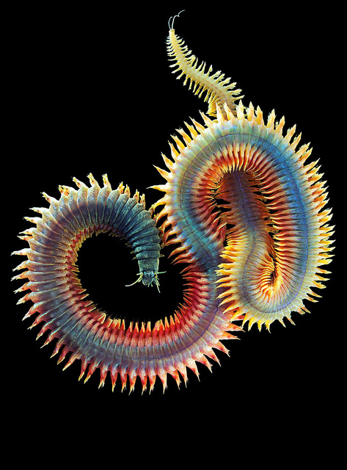
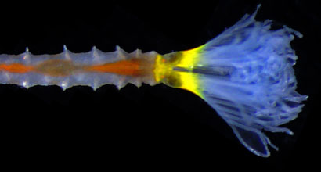
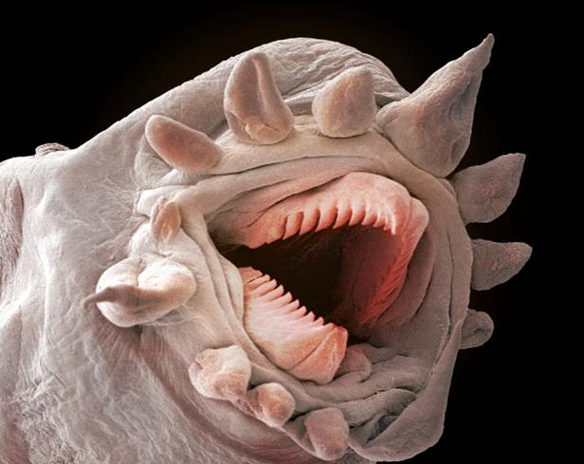
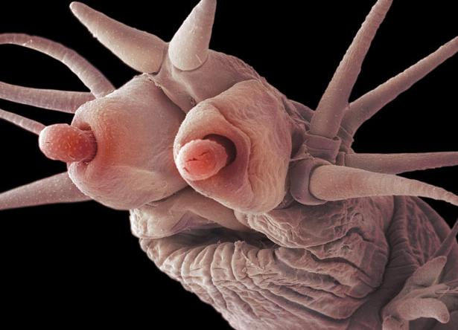
Polychaeta-Nature’s Beauty???

Slide 14
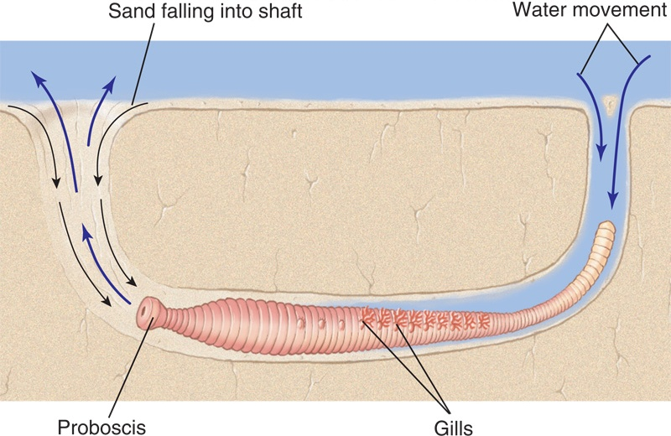
P. Annelida: C. Polychaeta
Circulation/respiration
most use parapodia + gills for gaseous exchange
others use body surface
dorsal vessel carries blood anteriorly
ventral vessel carries blood posteriorly
blood flows btwn dorsal/ventral vessels via segmental networks around parapodia/septa/intestine
many have respiratory pigments
Red pigment/Hemoglobin protein????

Slide 15
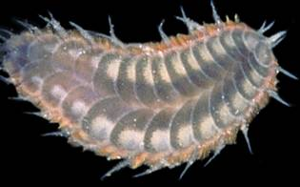
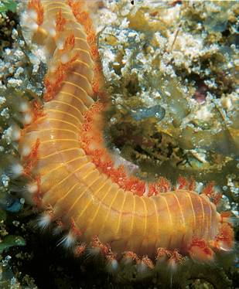
Scale worms
flattened bodies covered w/ broad scales
carnivorous some
Fireworms
hollow, brittle setae w/ poison
feed on cnidarians

Slide 16
Class Polychaeta
Many crawl, burrow into the seafloor, and many others live in tubes which the worms make using various sediment and mucus.
Use feathery tentacles to feed i.e. Christmas tree worm

Slide 17
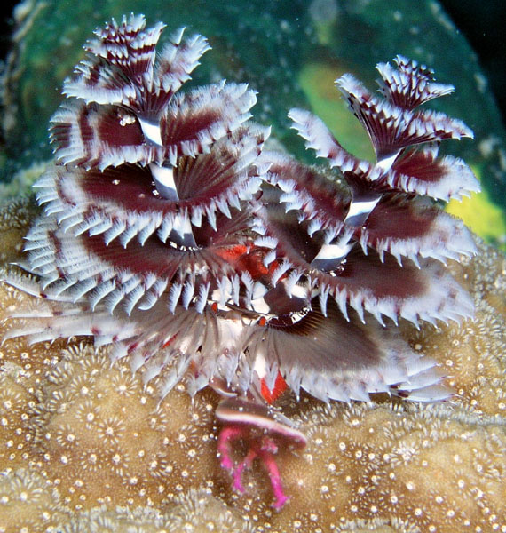
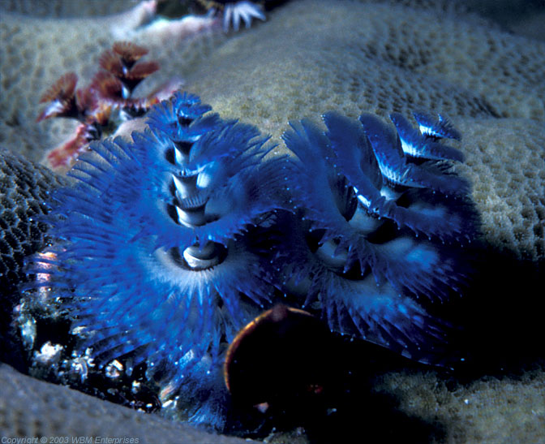
More Christmas Tree Worms!!!!!

Slide 18
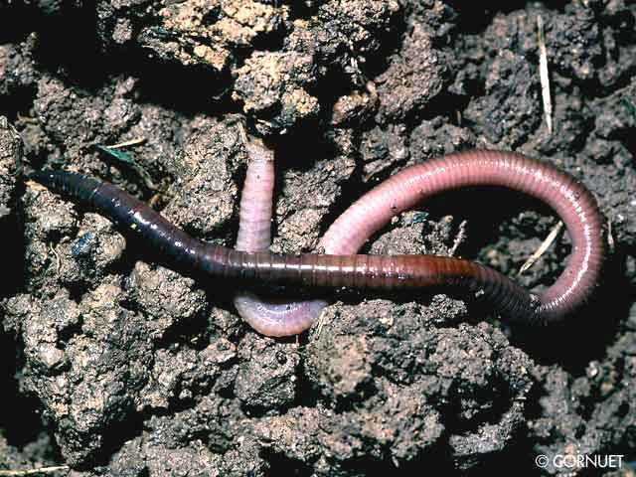
P. Annelida: C. Oligochaeta
Characteristics
+3000 sp.
terrestrial/freshwater
few marine/parasitic
variable # distinct segments
few setae per segment
no parapodia
no head
hermaphroditic
direct development (no larva)

Slide 19
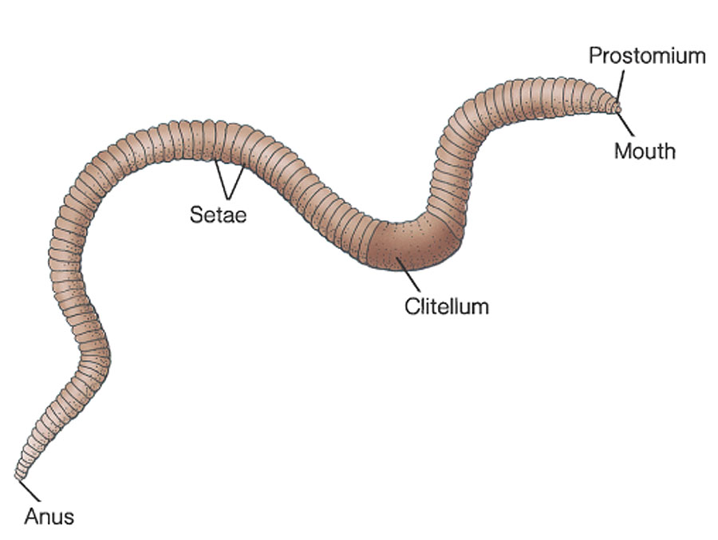
Copyright © The McGraw-Hill Companies, Inc. Permission required for reproduction or display.
External Structures of an Earthworm

Slide 20
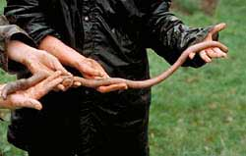
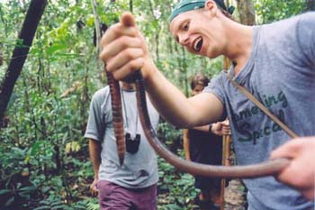
P. Annelida: C. Oligochaeta
earthworms
burrow in moist/rich soil
emerge at night
wet weather near surface
dry weather burrow deep, become dormant
earthworms have an important role in churning soil, mixing materials and adding nutrients
+15 tons of dry earth/acre/year passed through gut
Giant tropical earthworms
4 m
live in interconnected tunnels

Slide 21
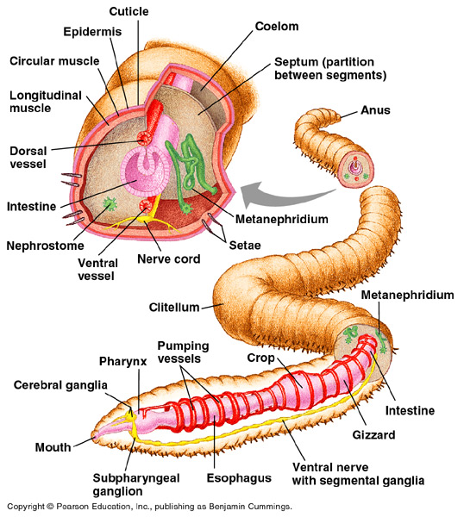

Slide 22
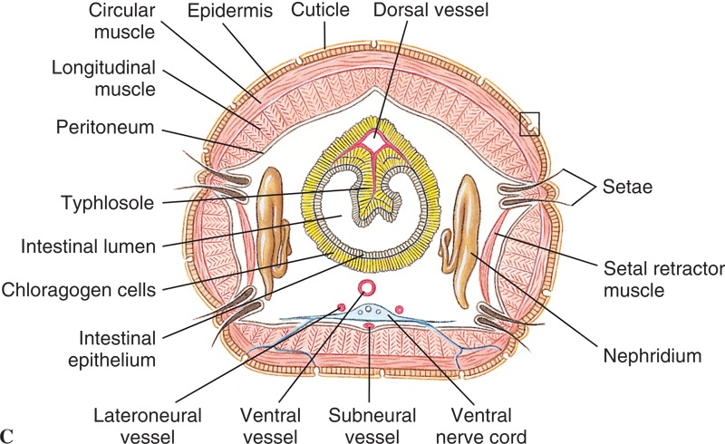
Class Oligochaeta
Form/func.
4 pair of chitinous setae per segment
some +100 pair
setae are bristlelike rod set in sac, move by tiny muscle
setae anchor segments during burrowing

Slide 23
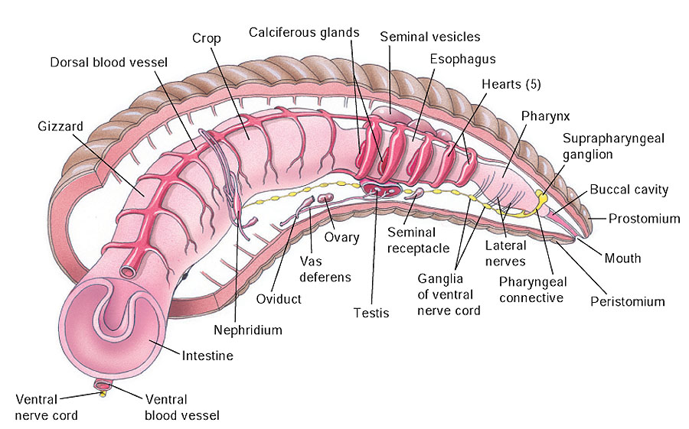
Copyright © The McGraw-Hill Companies, Inc. Permission required for reproduction or display.
Internal Structures of an Earthworm

Slide 24
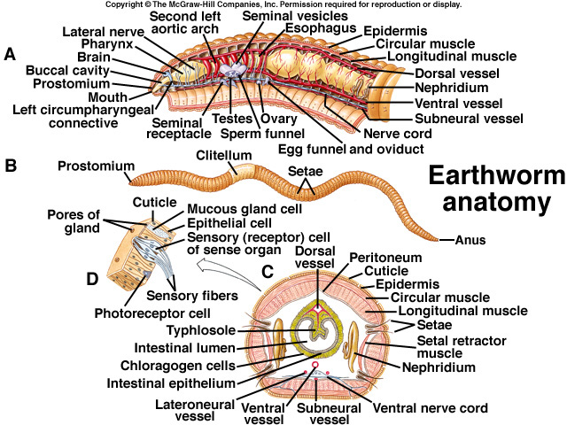

Slide 25
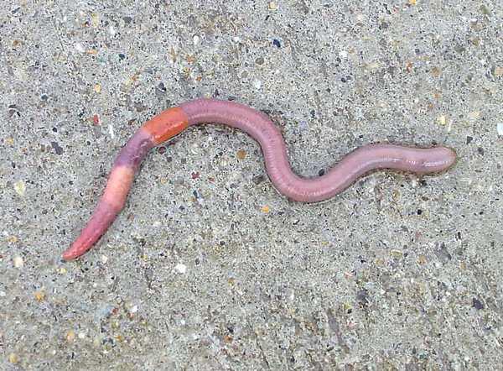
Undigested material, mixed with mucus secreted into the digestive tract, is egested (eliminated) as castings through the anus. Farmers value worms and casting because they improve the texture of the soil. Darwin estimated that 1 acre of British farmland had about 50,000 earthworm that produced 18 tons of castings per year.

Slide 26
Class Oligochaeta
Excretion of metabolic wastes occurs via nephridia
Each somite has a pair of nephridia
Wastes are dumped to a pore that discharges near the setae

Slide 27
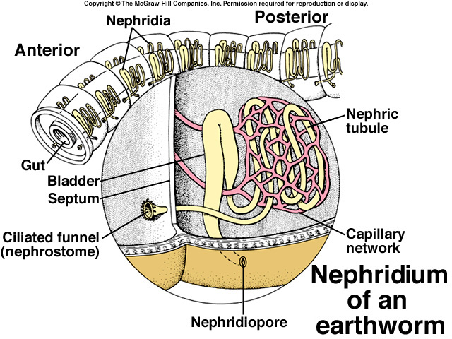

Slide 28
Metanephridium
Dorsal
vessel
Bladder
Nephridiopore
Nephrostome
Ventral vessel

Slide 29
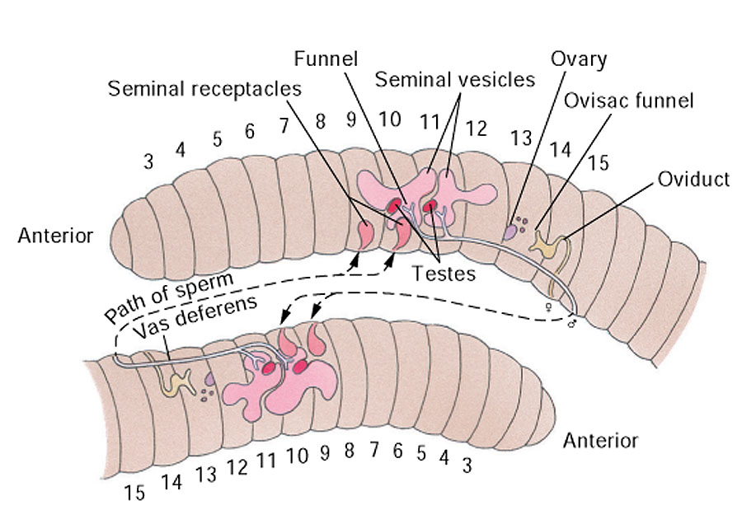
Copyright © The McGraw-Hill Companies, Inc. Permission required for reproduction or display.
Earthworm Reproduction

Slide 30
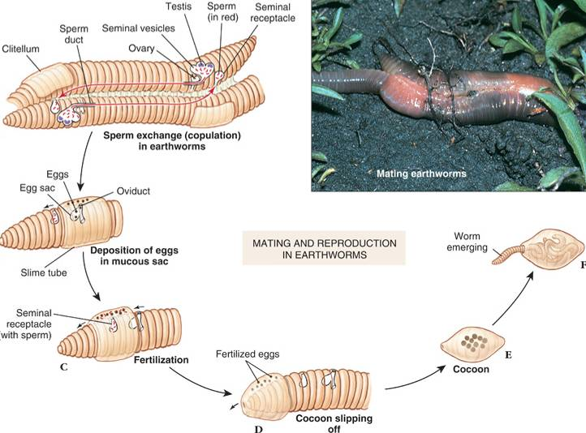

Slide 31
Class Hirudinea-The leeches
Most inhabit fresh water although some inhabit moist vegetation.
Many leeches feed on invertebrates while some are parasitic blood suckers attaching temporarily to other animals.
Some use blade like jaws to slit the skin of the host, other secrete enzymes that digest a hole through the skin.

Slide 33
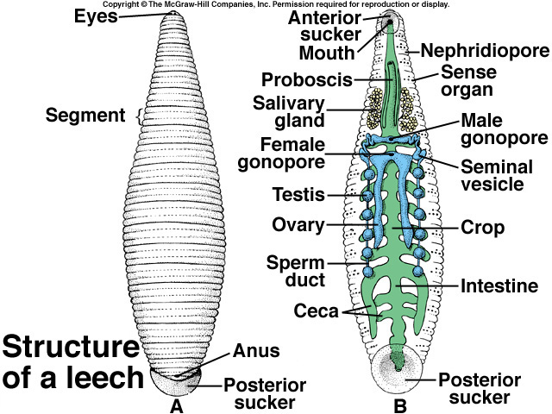

Slide 34
Secrete an anesthetic
Secrete hirudin
Keeps blood from clotting
The parasite will feed until it is full (up to 10 times its own weight) then it will fall off and not feed for up to 10 months.
Leeches are used for treating bruised tissues and stimulating circulation of blood to fingers and toes that have been sewn back to hands or feet after an accident.

Slide 35
2 major adaptations in this phylum:
1. The coelom
-provides a hydrostatic skeleton
-new and diverse methods of locomotion
-provides space for storage and complex organ development
2. Segmentation-allows high degree of specialization of body regions
-groups of segments modified for different functions

