Slide 1
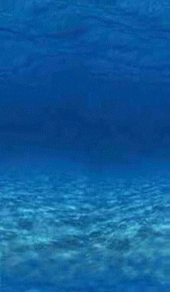
The Fishes: Vertebrate Success in Water
The Fishes: Vertebrate Success in Water
Chapter 18
Chapter 24

Slide 2
Fish vs. Fishes
“This tank is full of fish.”
“The ocean is full of fishes.”
Notes:
“Fish” refers to one or more individuals of one species; “fishes” refers to more than one species.

Slide 3
Phylum Chordata- notochord, pharyngeal slits, dorsal tubular nerve cord, postanal tail.
What is a Fish?

Slide 4
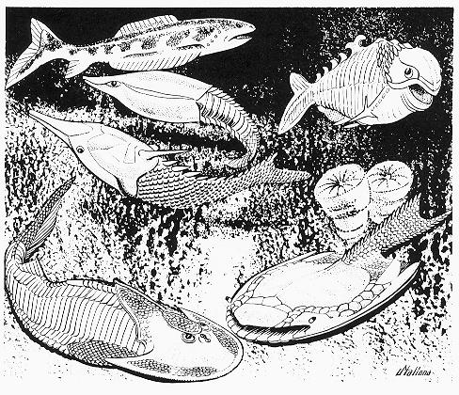
Evolutionary Evidence
Hagfish are the most primitive living craniates.
2 Key craniate characteristics is: the brain and bone
530 million years ago possible fossil with brain
500 million years ago bone well developed in group of fishes called Ostracoderms (bony armor)
The first vertebrates were fishlike animals that appeared more than 500 million years ago. The internal skeletons of these jawless creatures were cartilaginous and rarely preserved. Ostracoderms had bony external shields that covered the head and most of the trunk.
Notes:
Ostracoderms: The First Vertebrates (PA-18) The first vertebrates were fishlike animals that appeared more than 500 million years ago. The internal skeletons of these jawless creatures were cartilaginous and rarely preserved. Ostracoderms had bony external shields that covered the head and most of the trunk.
From 3 to 10 inches long, ostracoderms had rather thick, flattened bodies with only a pair of side flaps to help in steering. They probably swam clumsily just above the sea floor. The mouth served to obtain oxygen and to retain bits of food.
After true fish appeared about 400 million years ago, most ostracoderms rapidly became extinct. An armorless type survived, giving rise to modern lampreys and hagfish. Some ostracoderm plates are found in Devonian bone beds in Indiana.

Slide 5
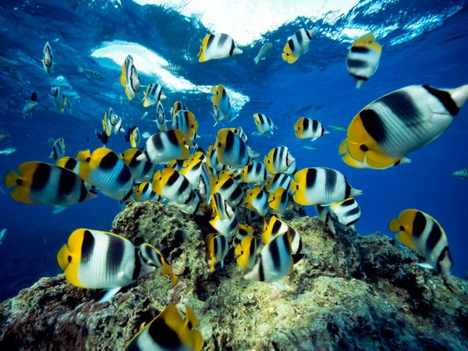
Evolutionary Evidence
First vertebrates probably marine
Vertebrates did adapt to freshwater and much of the evolution of fish occurred there.
Early vertebrate evolution involved the movement of fishes back and forth between marine and freshwater environments.

Slide 6
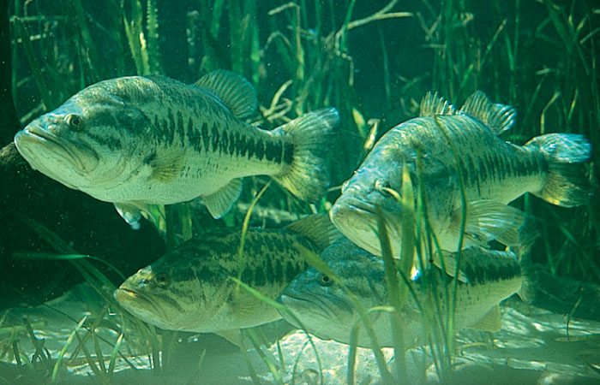
Evolutionary Evidence
The importance of freshwater in the evolution of fishes is evidenced by the fact that over 41% of all fish species are found in freshwater, even though freshwater habitats represent only a small percentage (0.0093% by volume) of the earth’s water resources.

Slide 7
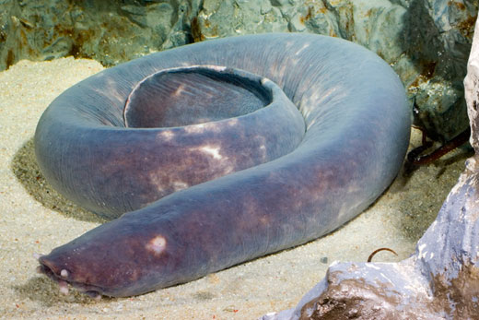
Living Jawless fishes
Class Myxini: The Hagfish
Head-supported
by cartilaginous
bars
Brain- enclosed
in fibrous sheath
Intro video to Hagfish

Slide 8
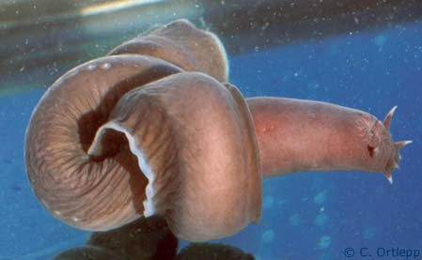
Class Myxini
Lack vertebrae
Retain notochord (axial supportive structure)
4 pairs of sensory tentacles surrounding their mouths
Ventrolateral slime glands
See the copious amounts of slime
See hagfish make a knot

Slide 9
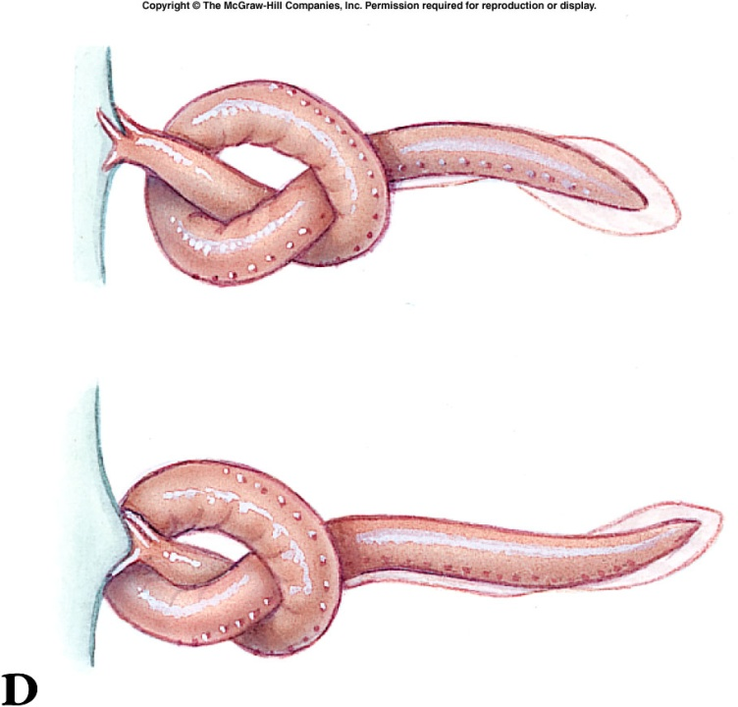
Class Myxini
Found: cold water marine habitats
Feed on: soft bodied invertebrates or scavenge on dead or dying fish
To provide leverage, the hagfish ties a knot in its tail and passes it forward to press against the prey
Eating on dead whale carcass

Slide 11
Subphylum Vertebrata
Vertebrae that surrounds a nerve cord and serves as the primary axial support
Most are vertebrates are members of the superclass Gnathostomata
Jawed fishes
Tetrapods

Slide 12
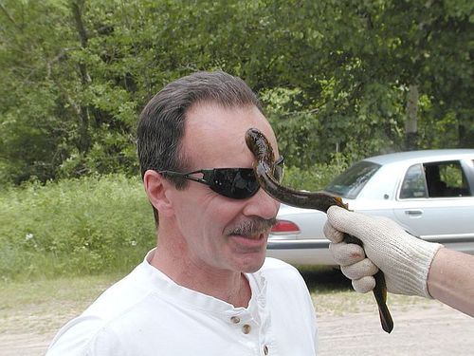
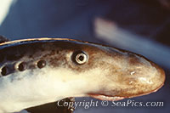
Class Petromyzontida
Petros- stone, myzon-sucking
Lampreys -agnathans

Slide 13
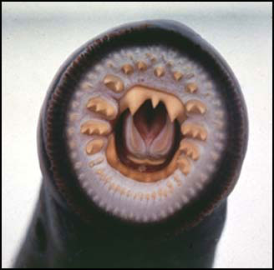
Class Petromyzontida
Live in both marine and freshwater
Larva filter feeders
Adults prey on fish
Mouth –suckerlike with lips for attachment functions

Slide 14
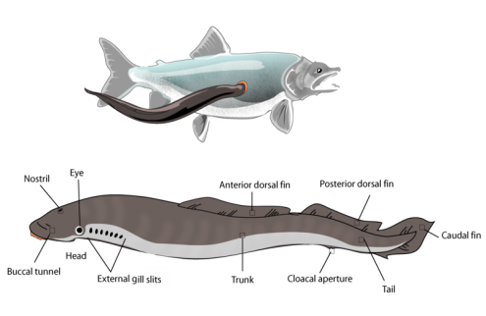
Attach to prey with lips and teeth
Use tongues to rasp away scales

Slide 15
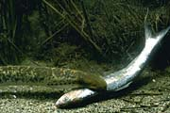
Class Petromyzontida
Salivary glands with anticoagulant; feed on blood

Slide 16
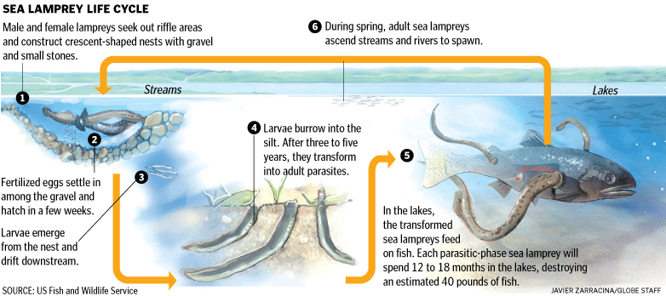
Sea lamprey Reproduction:

Slide 17
Body parts of fish
Get ready to draw a fish!!!

Slide 18
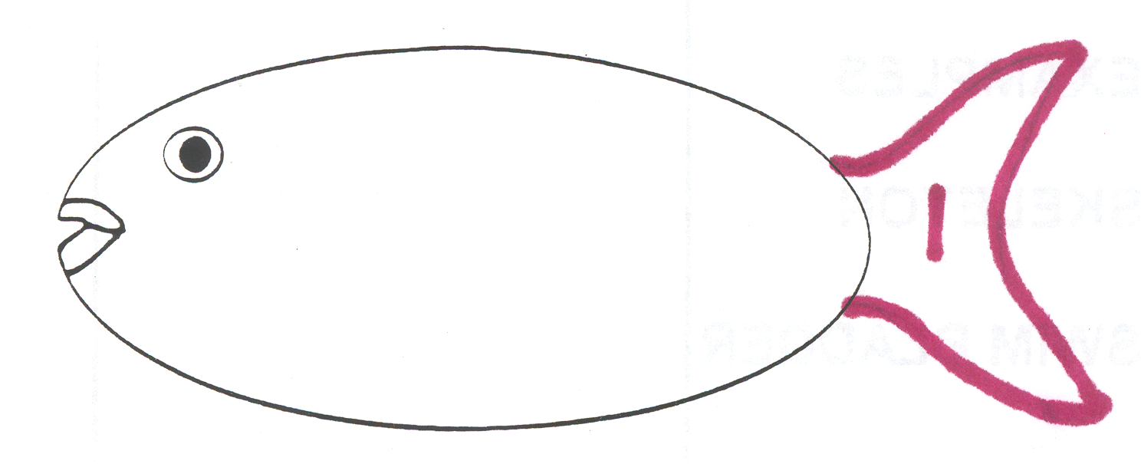
1. Caudal fin - tail fin
Used for forward motion and acceleration

Slide 19
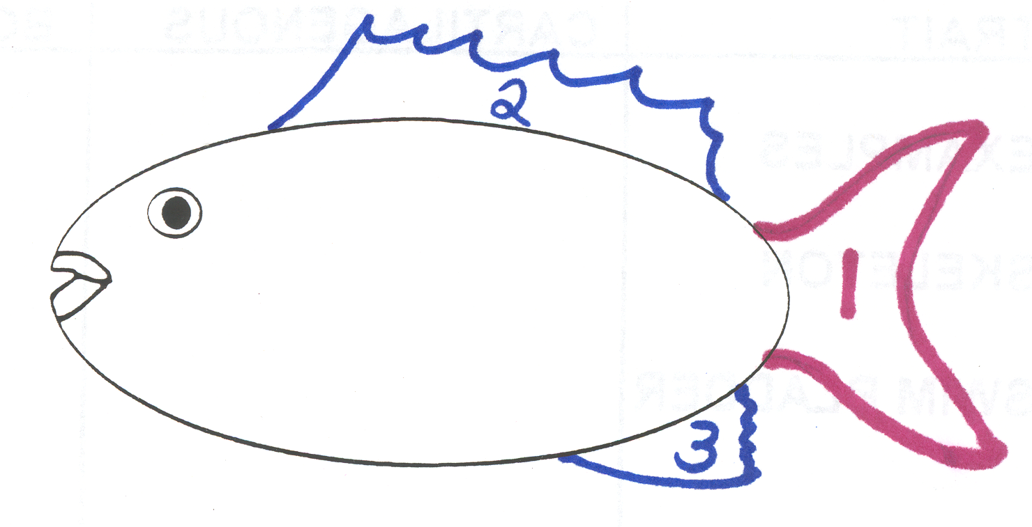
2. Dorsal fin & 3. Anal fin
Singular fins
Used to prevent rolling/tipping

Slide 20
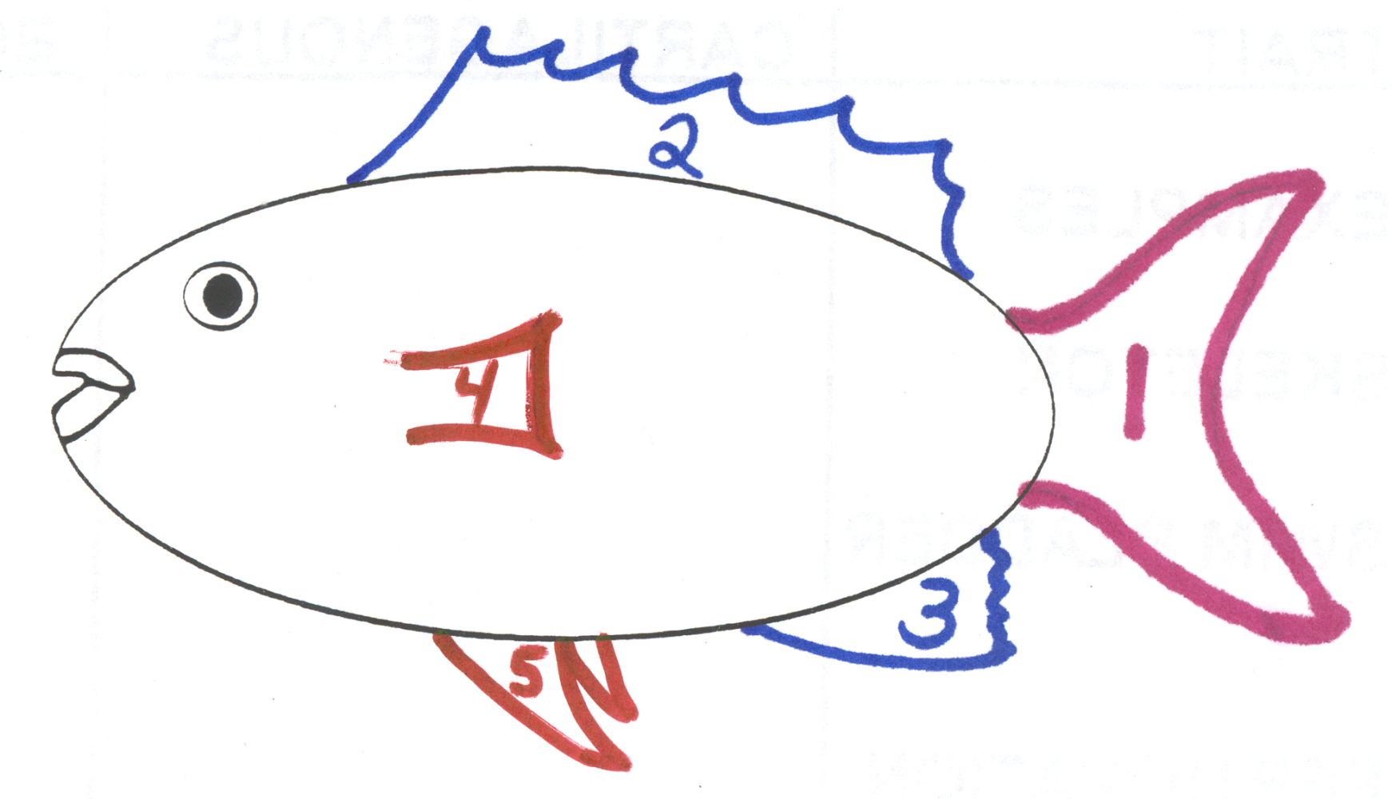
4. Pectoral fin & 5. Pelvic fin
Paired fins (left & right)
Used to balance, stop & turn

Slide 21
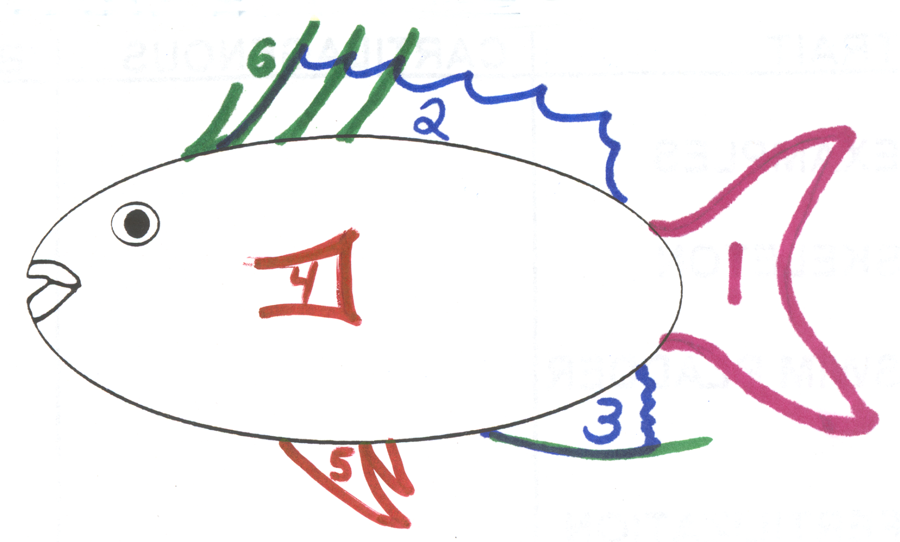
6. Spines
Used for protection
Some contain poison sacs

Slide 22
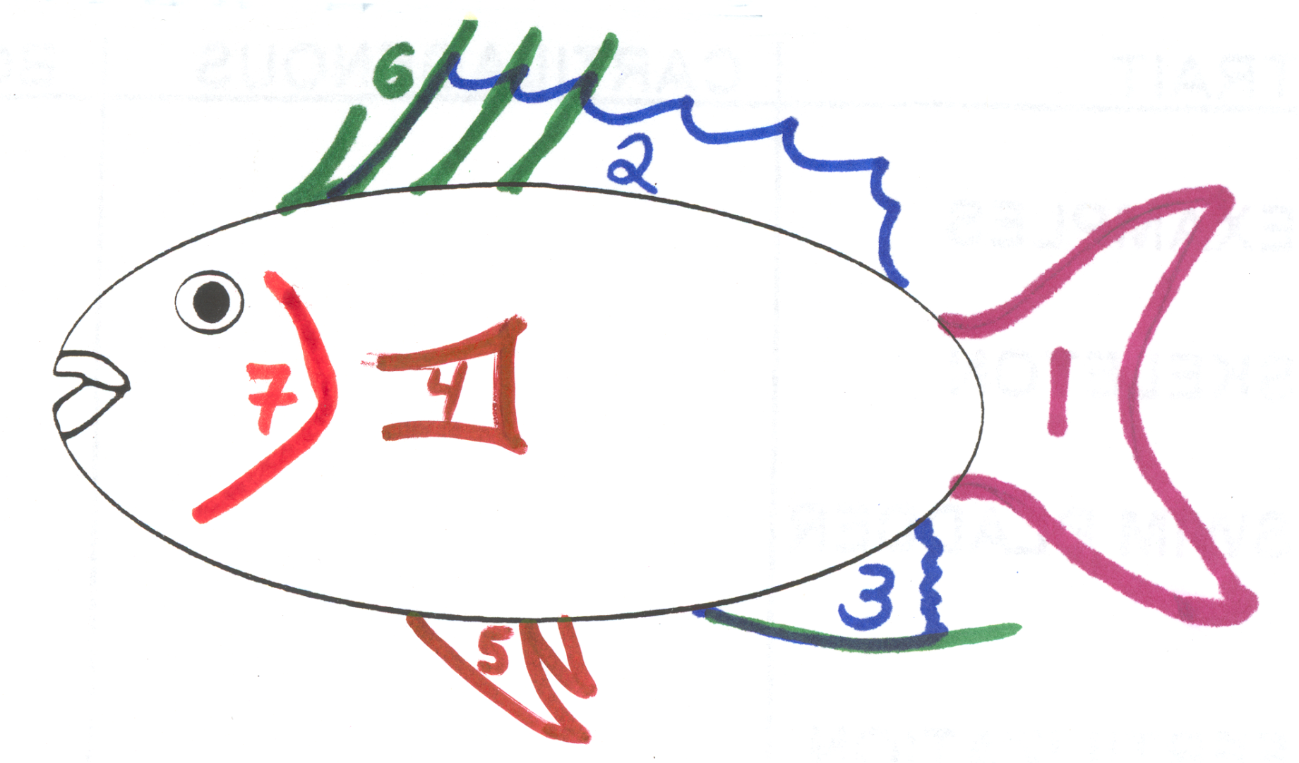
7. Operculum
Covers & protects gills
Not found in sharks

Slide 23
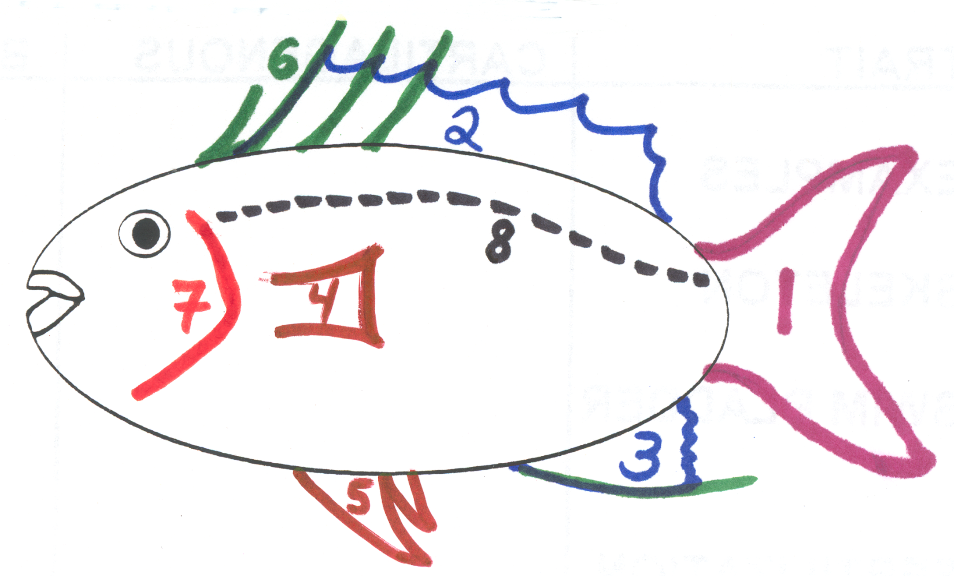
8. Lateral line
Sensory canals used to detect changes in water pressure around the fish (similar to human ear)

Slide 25
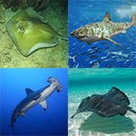
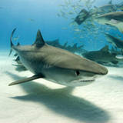
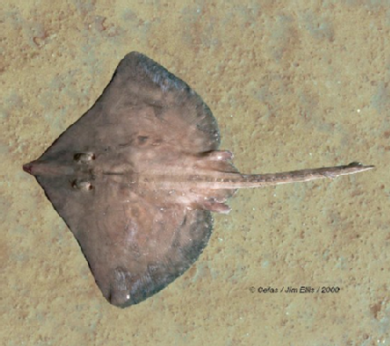
Class Chondrichthyes
Chondro- cartilage, ichthyes- fish
Sharks, skates, rays, ratfish
Carnivores or scavengers
Most marine

Slide 26
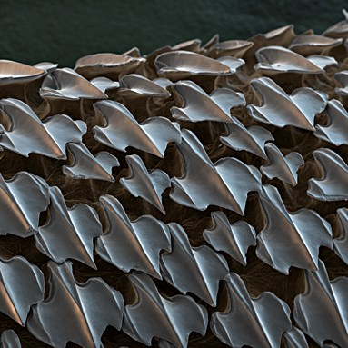
Class Chondrichthyes
Biting mouthparts
Paired appendages
Placoid scales (gives skin tough, sandpaper texture)
Cartilaginous endoskeleton
These sharply pointed placoid scales are also known as dermal teeth or denticles. They give the shark’s skin the feel of sandpaper. The tip of each scale is made of dentine overlayed with dental enamel. The lower part of each scale is made of bone. The scales disrupt turbulence over the skin, considerably reducing the drag on the shark as it swims.
Notes:
Dried shark skin has been used for sandpaper! ☺

Slide 27
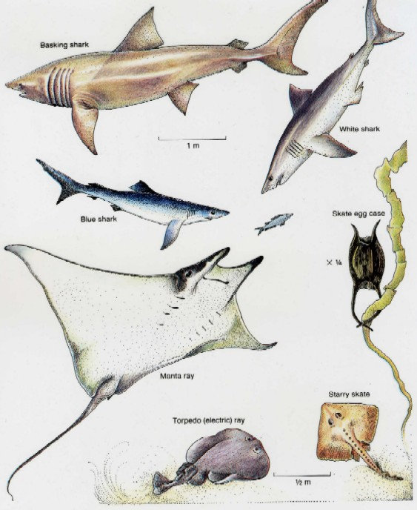
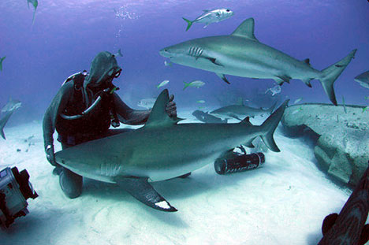
Class Chondrichthyes
Subclass Elasmobranchii
elasmos- plate metal, branchia- gills
Sharks, skates, rays
820 species
Placoid scales

Slide 28
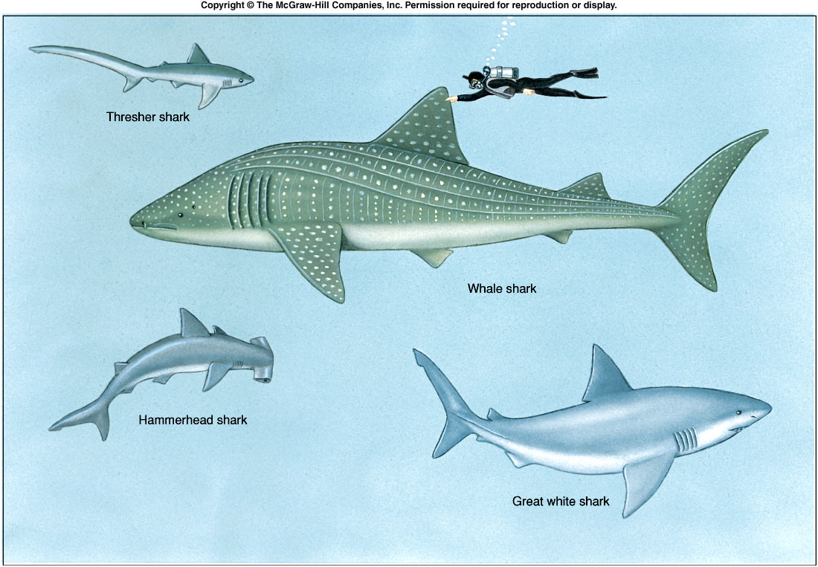
Notes:
Fig. 24.7

Slide 29
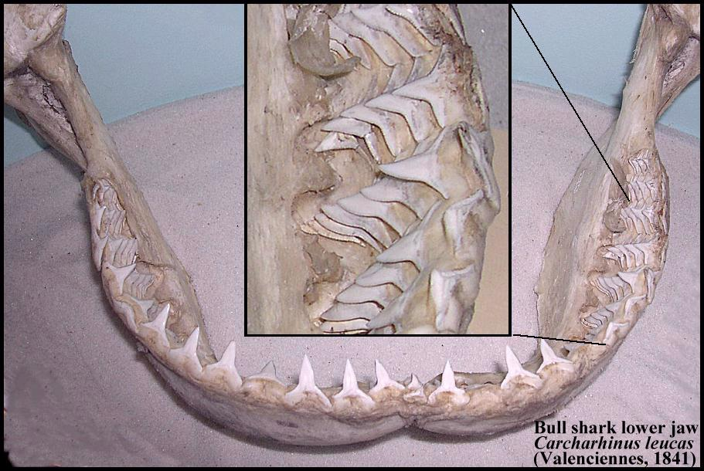
Subclass Elasmobranchii
Shark teeth are modified placoid scales
Rows of teeth
As outer teeth wear out, newer teeth move into position from inside jaw and replaces them
How many
teeth do sharks have?

Slide 30
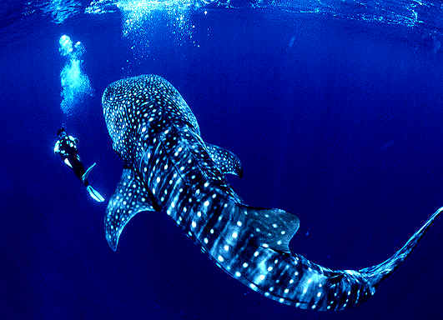
Subclass Elasmobranchii
Largest living sharks?
Filter feeders- whale shark
Pharyngeal-arch modifications that strain plankton

Slide 31
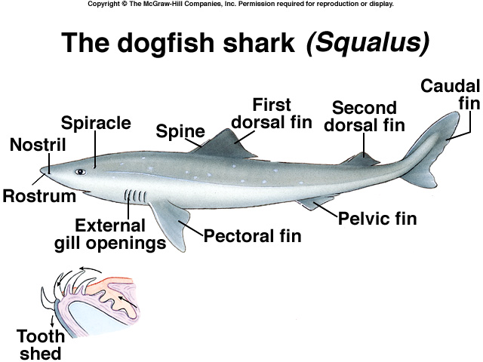

Slide 34
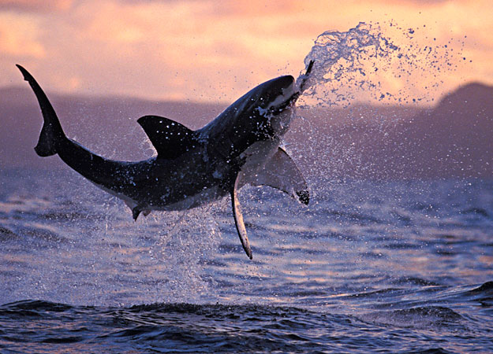
Subclass Elasmobranchii
Fiercest most feared sharks?
Great white shark
Great White Shark (Carcharodon carcharias),South Africa, Atlantic Ocean.
Notes:
Jaws theme song on subclass! ☺ FYI the book says great white and mako? I question mako???

Slide 35
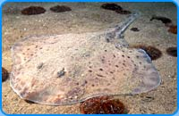
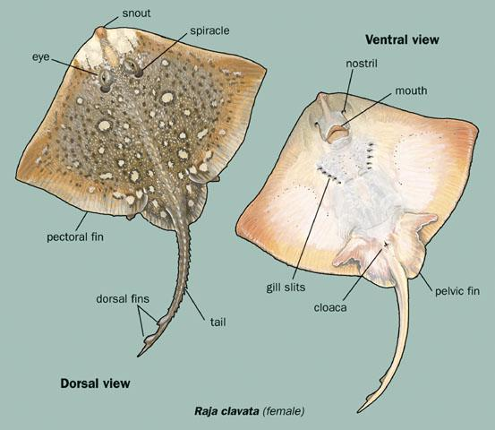
Subclass Elasmobranchii
Skates and rays
Life on the ocean floor in shallow waters
Wing like appendages
Camouflage
The little skate settles on the ocean floor where it blends in with the light colored sand. It can easily surprise any prey while waiting in this position.

Slide 37
Osteichthyes
Osteo- bone, ichthyes- fish
Bone in skeleton and/or scales
Bony operculum covering the gill openings
Lungs or swim bladder

Slide 38
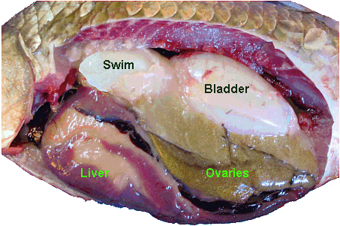
Class Actinopterygii
Actin- ray, pteryx-fin
Ray-finned fishes because their fins lack muscular lobes
Swim bladder-gas-filled sacs along the dorsal wall of the body cavity that regulates buoyancy
Swim_bladder of a Rudd (Scardinius erythrophthalmus)

Slide 39
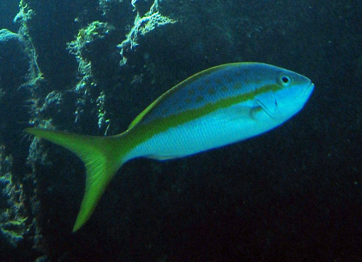
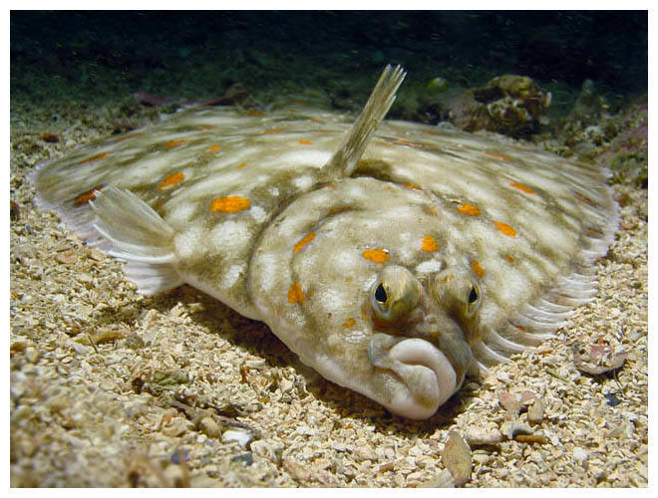
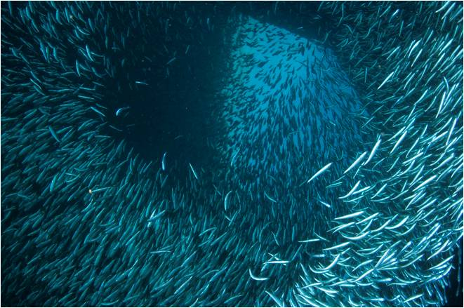
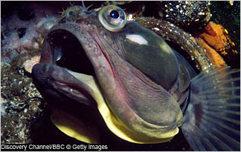
What is the largest successful vertebrate group?
Fishes

Slide 40
Why are fishes so successful?
Adapt to environment
Extract oxygen from small amounts of oxygen per unit volume
Efficient locomotor structures
High sensory system
Efficient reproduction (produces overwhelming number of offspring)

Slide 41
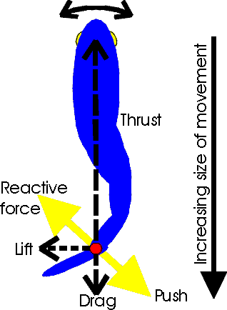
Locomotion
Stream line shape
Mucoid secretions lubricates body to decrease friction between fish and water
Use fins and body wall to push against water.
The muscles provide the power for swimming and constitute up to 80% of the fish itself. The muscles are arranged in multiple directions (myomeres) that allow the fish to move in any direction.

Slide 42
Locomotion
The trunk and tail musculature propels a fish.
Muscles are arranged in zigzag bands called myomeres; they have the shape of a W on the side of the fish.
Internally the bands are folded and nested; each myomere pulls on several vertebrae.
Notes:
Fig. 24.Fig. 24

Slide 43
Nutrition and Digestion
Most are predators (always searching for food)
Invertebrates, vertebrates
Swallow prey whole
Capture prey: suction-closing the opercula and rapidly opening mouth
Some filter feeders- Gill rakers: trap plankton while the fish is swimming with mouth open.
Some herbivores and omnivores

Slide 44
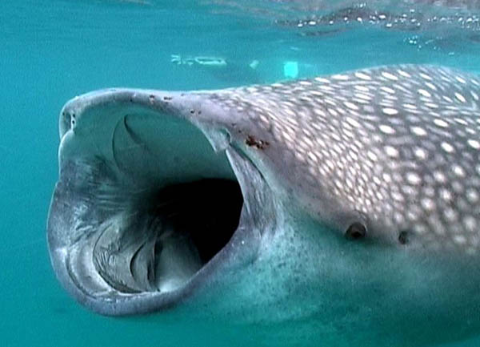
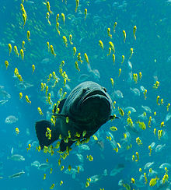
Nutrition and Digestion
Whale Sharks live in the Tropical Warm Waters all around the world. For eating, they swim quite near the water surface.
A giant grouper seen
swimming among schools of other fish

Slide 45
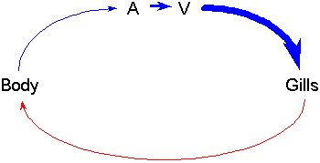
Circulation and Gas Exchange
The heart only has two chambers
Fish heart only pumps blood in one direction

Slide 46
The blood enters the heart through a vein
Exits through a vein on its way to the gills.
In the gills, the blood picks up oxygen from the surrounding water and leaves the gills in arteries, which go to the body.
The oxygen is used in the body and goes back to the heart.
A very simple closed-circle circulatory system.

Slide 47
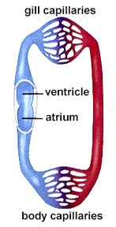
SINGLE loop CLOSED circulation

Slide 48
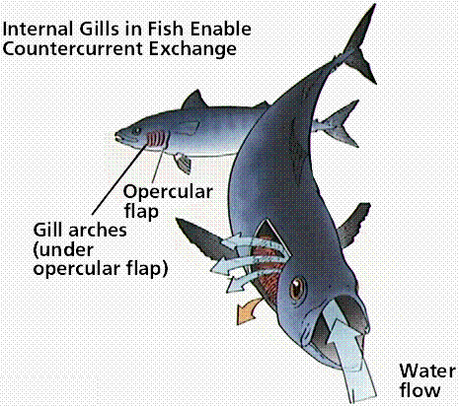
Circulation and Gas Exchange
The gills
the gills are composed of
a gill arch (which gives the gill rigid support),
gill filaments (always paired)
secondary lamellae (where gas exchange takes place)

Slide 49
RESPIRATORY
Gill Arch
Gill Filaments

Slide 50
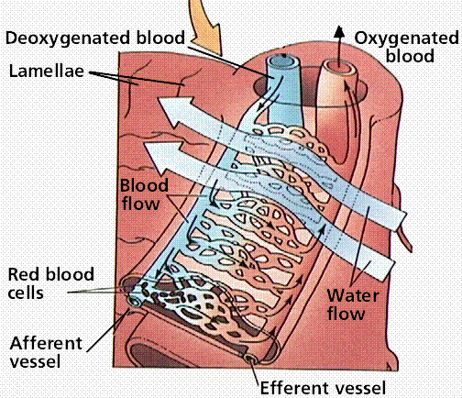
Circulation and Gas Exchange
The blood flows thorough the gill filaments and secondary lamellae in the opposite direction from the water passing the gills.
This is very important for getting all of the available oxygen out of the water and into the blood

Slide 51
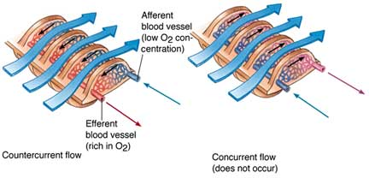
The countercurrent exchange system
Provides very efficient gas exchange by maintaining a concentration gradient between the blood and the water over the entire length of the capillary bed.

Slide 52
COUNTERCURRENT FLOW
Diagram by Riedell

Slide 53
COUNTERCURRENT FLOW

Slide 54
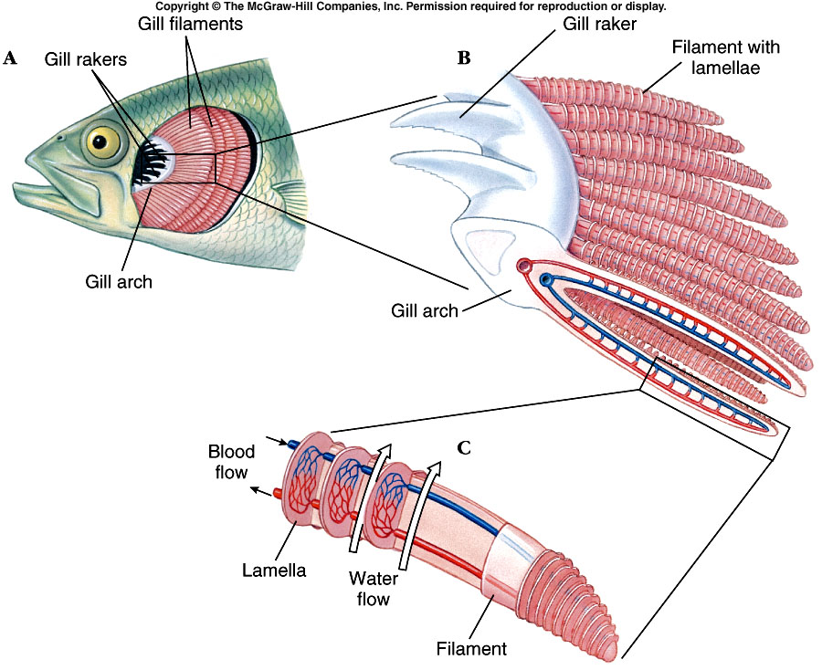
Notes:
Fig. 24.28

Slide 55
Circulation and Gas Exchange
How do fish ventilate their gills?
Fish must pass new water over their gills continuously to keep a supply of oxygenated water available for diffusion.
Fishes use two different methods
Ram Ventilation
Double pump system

Slide 56
Ram Ventilation
Swim through the water and open your mouth (ram water into mouth)
include the great white shark, the mako shark, the salmon shark and the whale shark , tuna

Slide 57
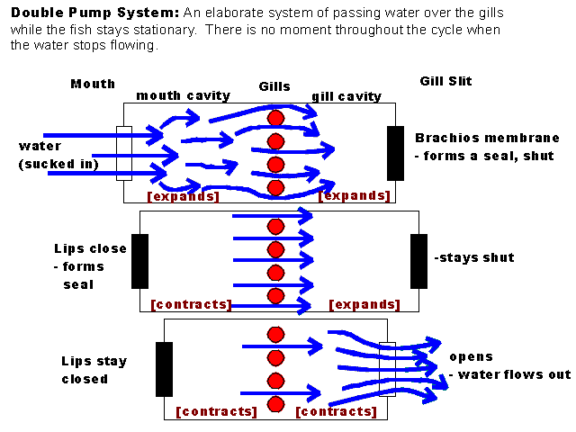

Slide 58
FYI
When fish are taken out of the water, they suffocate. This is not because they cannot breathe the oxygen available in the air, but because their gill arches collapse and there is not enough surface area for diffusion to take place. There are actually some fish that can survive out of the water, such as the walking catfish (which have modified lamellae allowing them to breathe air.
It is possible for a fish to suffocate in the water. This could happen when the oxygen in the water has been used up by another biotic source such as bacteria decomposing a red tide. SEE March 8,2011

Slide 59
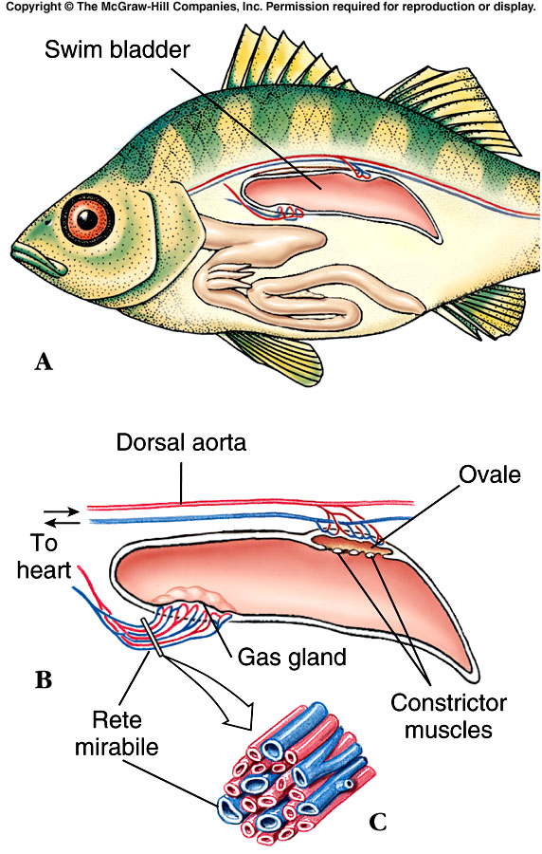
Circulation and Gas Exchange
Swim bladders-help to maintain buoyancy in the water.
a sac inside the abdomen that contains gas.

Slide 60
4 Ways Fishes can Maintain their Vertical Position
1. Fishes are saturated with buoyant oils. (especially in liver)
2. Use their fins to provide lift.
3. Reduction of heavy tissues. (bones less dense, cartilaginous skeletons)
4. Swim bladder.

Slide 61
Nervous and Sensory Functions
Has a brain and a spinal cord
External nares – in snouts of fishes lead to olfactory receptors
Salmon and lampreys return to streams they were spawned from due to the odors
Eyes – lidless with round lenses; focus by moving lens forward or backward
Inner ears – equilibrium, balance, hearing (similar to other vertebrates)

Slide 62
Nervous and Sensory Functions
Lateral-line system – sensory pits in epidermis detect water currents (from predators) or low frequency sounds
Electroreception – detection of electrical fields that the fish or another organism generates
Highly developed in the rays and sharks
Notes:
Sharks cannot detect organisms wrapped in polyvinyl insulated sheets/bags. That’s why downed aircrafts use them.

Slide 63
Nervous and Sensory Functions
Electric fish – currents circulate from electric organs in fish’s tail to electroreceptors near its head
an object in the field changes the pattern
Live in murky fresh waters in Africa or Amazon basin in South America
EX: electric eel (bony fish)
Shocks in excess of 500 volts
EX: electric ray (an elasmobranch)
Pulses of 50 volts

Slide 64
Excretion and Osmoregulation
Kidneys and gills- maintain proper balance of electrolytes (ions) and water in their tissues
Nephrons- excretory structures in the kidneys that filter bloodborne nitrogenous waste, ions, water, and small organic compounds across a network of capillaries called: glomerulus
Filtrate passes to a tubule system essential components are absorbed into blood filtrate remaining- is excreted

Slide 65
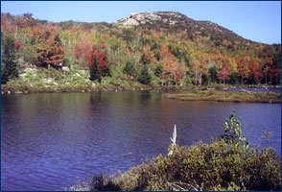
Freshwater Fishes
Never drink!
Only take in water when eating.
Numerous nephrons with LARGE glomeruli and SHORT tubule systems
Little water reabsorbed
Large quantities of diluted urine
Active transport of ions into blood
Get salt in their food

Slide 66
Notes:
Fig. 24.29

Slide 68
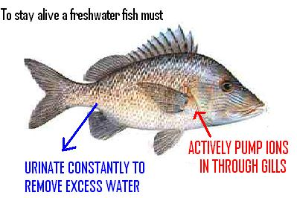

Slide 69
Marine Fishes
Must combat water LOSS
3.5% ions in environment 0.65% ions in tissues
Drink water
Eliminate excess ions by excretions, defection, and active transport across gill.
Nephrons -SMALLER glomerculi and LONGER tubule systems
Water absorbed from nephrons

Slide 70
Notes:
Fig. 24.29

Slide 73
Reproduction and Development
Ovoparous-- Lay undeveloped eggs, External fertilization (90% of bony fish), Internal fertilization (some sharks and rays)
fish lay huge numbers of eggs; a female cod may release 4-6 million eggs.
Ovoviviparous- Internal development- without direct maternal nourishment-Advanced at birth (most sharks + rays)-Larval birth (some scorpeaniforms-rockfish)
Notes:
In fishes, oviparity is most common; the eggs are inexpensive to produce, and as eggs are in the water, they do not dry out (oxygen, nutrients are not scarce). The adult can produce many offspring, which they broadcast into the plankton column. When the offspring settle out of the plankton, they may be in totally new environments, allowing for a great area in which the young may survive. This mode also comes with its disadvantages; when born, the fish must first go through a larval stage for growth before they transform into the adult stage. In this larval stage, they must fend for themselves in obtaining food and avoiding predation. They may not find a suitable environment when they settle out of the plankton column. The survival of individual eggs is very low, so millions of eggs must be produced in order for the parent to successfully produce offspring. The other modes have their advantages, the eggs are much less prone to predation when carried within the mother, and the young are born fully advanced and ready to deal with the environment as miniature adults. These advantages come with a price-tag also; the adult must supply nutrients to its offspring and can only produce a few eggs at a time. The young are limited to the environment that their parents were in, and if this environment is deteriorating, they are stuck with it.

Slide 74
Reproduction and Development
Viviparous- Internal development- direct nourishment from mother-Fully advanced at birth (some sharks, surf perches)

